Slide 1

Nirma University
E-commerce website
Smit Chaklasiya (20BCE036) B.Tech 8th Semester Major Project Department of Computer Science & Engineering Guided By: Sharda Valiveti
May 2024
Smit Chaklasiya (20BCE036) B.Tech 8th Sem Major Project
E-commerce website

Slide 2

Internship Details
Company Name | Vasoya Brothers Infotech PVT. LTD
Address | 110, Shreenathji Icon, VIP Cir, Uttran, Surat, Gujarat 394105
Role | SDE
Joining Date | 08 / 01 / 2024
Smit Chaklasiya (20BCE036) B.Tech 8th Sem Major Project
E-commerce website

Slide 3



About Company
Founded in 2013, Crest Data Systems is a top supplier of customized solutions in the following domains: cloud, ITOps/AIOps, Cyber Security, DevOps, and data analytics. The company is situated in the Bay Area of California. Crest is a rapidly expanding company that develops cutting-edge technologies. Its clientele includes some of the hottest Silicon Valley start-ups and numerous Fortune 500 companies. Crest offers a comprehensive range of services encompassing Development, Consulting/Professional, and 24x7 Managed services. These services enable companies to create market-leading solutions to surpass their competitors and remain innovative.
Product Engineering
Managed Services
Professional Services
Tirth Patel (20BCE223) B.Tech 8th Sem Major Project
Cloud Security Platform

Slide 4
Project Details
Cloud Security Platform
The cloud security platform is designed to offer comprehensive visibility and control over data center and load balancer infrastructure, catering to the diverse needs of modern organizations in ensuring robust security and operational efficiency. Key components of the platform include tenant management, data center management, role-based access control, and IT management functionalities.
Tirth Patel (20BCE223) B.Tech 8th Sem Major Project
Cloud Security Platform

Slide 5










Technology Used
Frontend
Backend
Tirth Patel (20BCE223) B.Tech 8th Sem Major Project
Cloud Security Platform

Slide 6




Key Features
Monitoring
Load Balancers Status
Role
Based
Access
Control
Feedback
Management
User & Tenant
Management
Tirth Patel (20BCE223) B.Tech 8th Sem Major Project
Cloud Security Platform

Slide 7
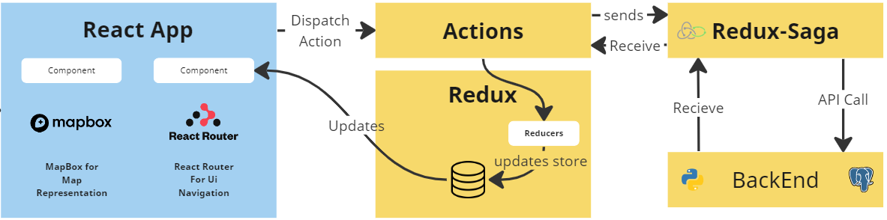
System Architecture
Tirth Patel (20BCE223) B.Tech 8th Sem Major Project
Cloud Security Platform

Slide 8
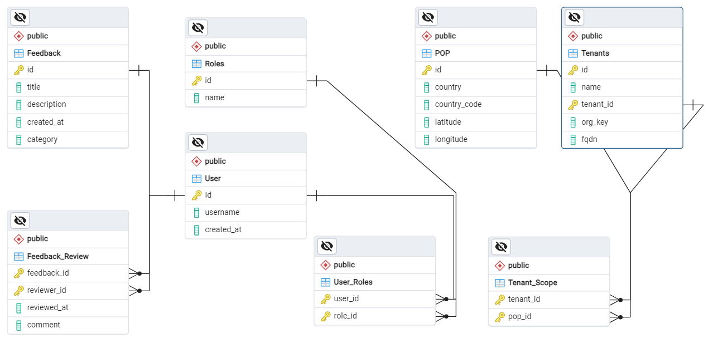
ERD Diagram
Tirth Patel (20BCE223) B.Tech 8th Sem Major Project
Cloud Security Platform

Slide 9
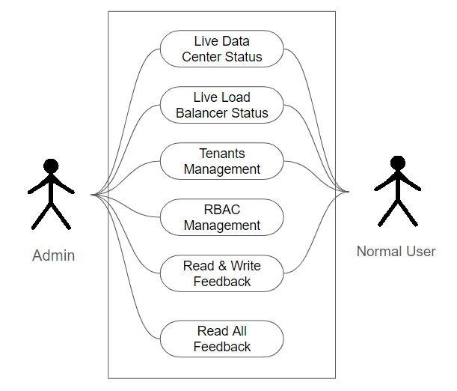
Use Case Diagram
Tirth Patel (20BCE223) B.Tech 8th Sem Major Project
Cloud Security Platform

Slide 10
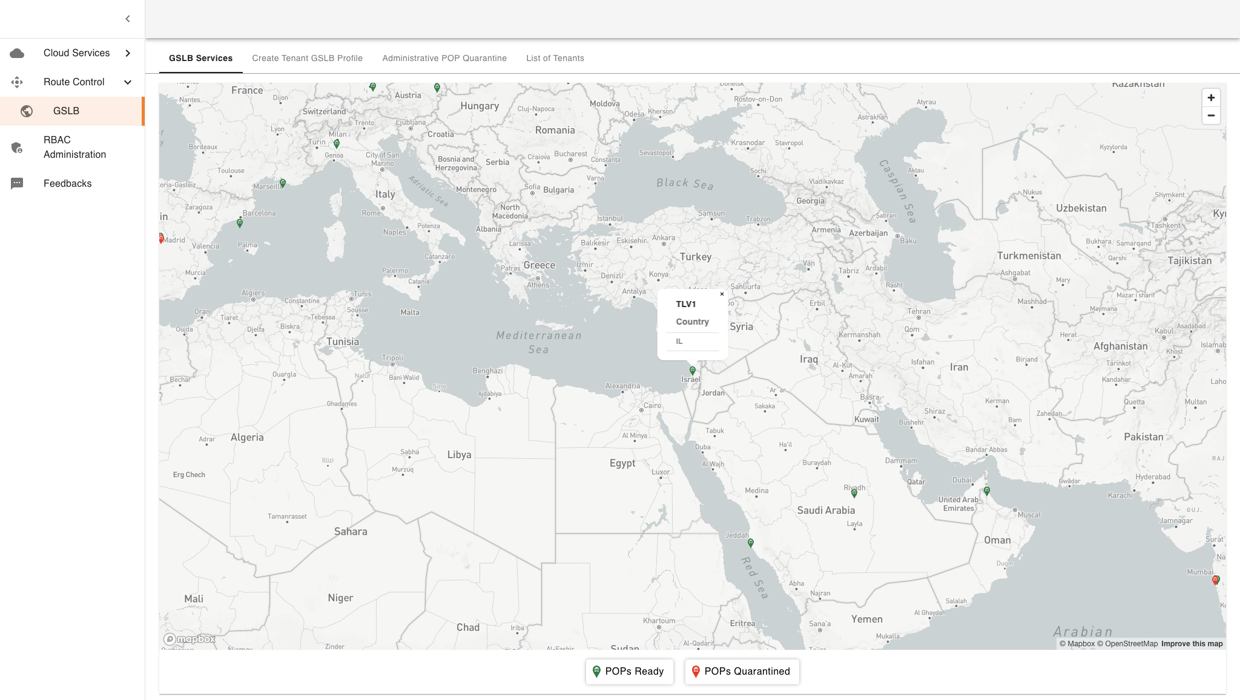
Project Details
Tirth Patel (20BCE223) B.Tech 8th Sem Major Project
Cloud Security Platform

Slide 11
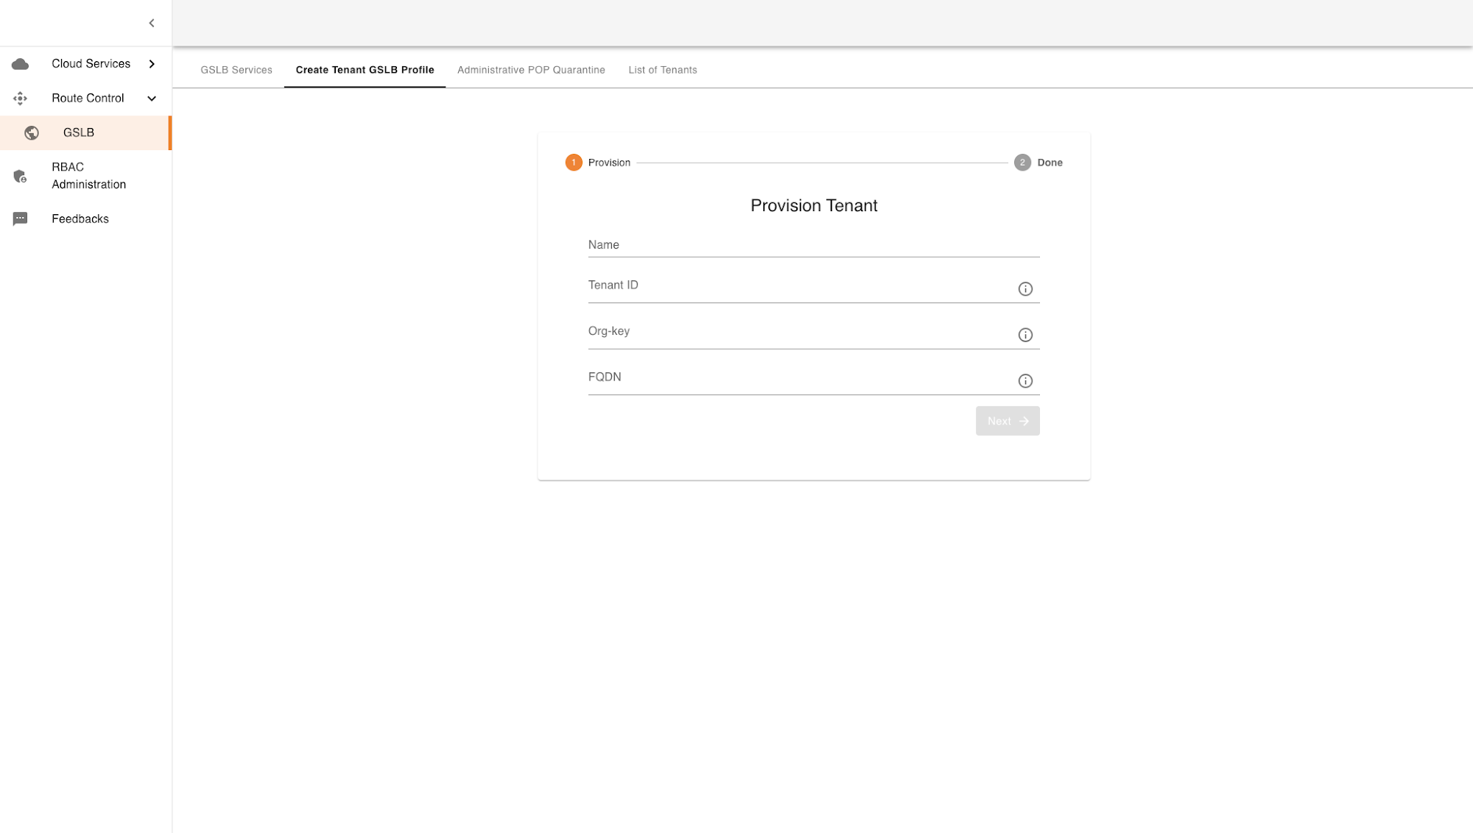
Project Details
Tirth Patel (20BCE223) B.Tech 8th Sem Major Project
Cloud Security Platform

Slide 12
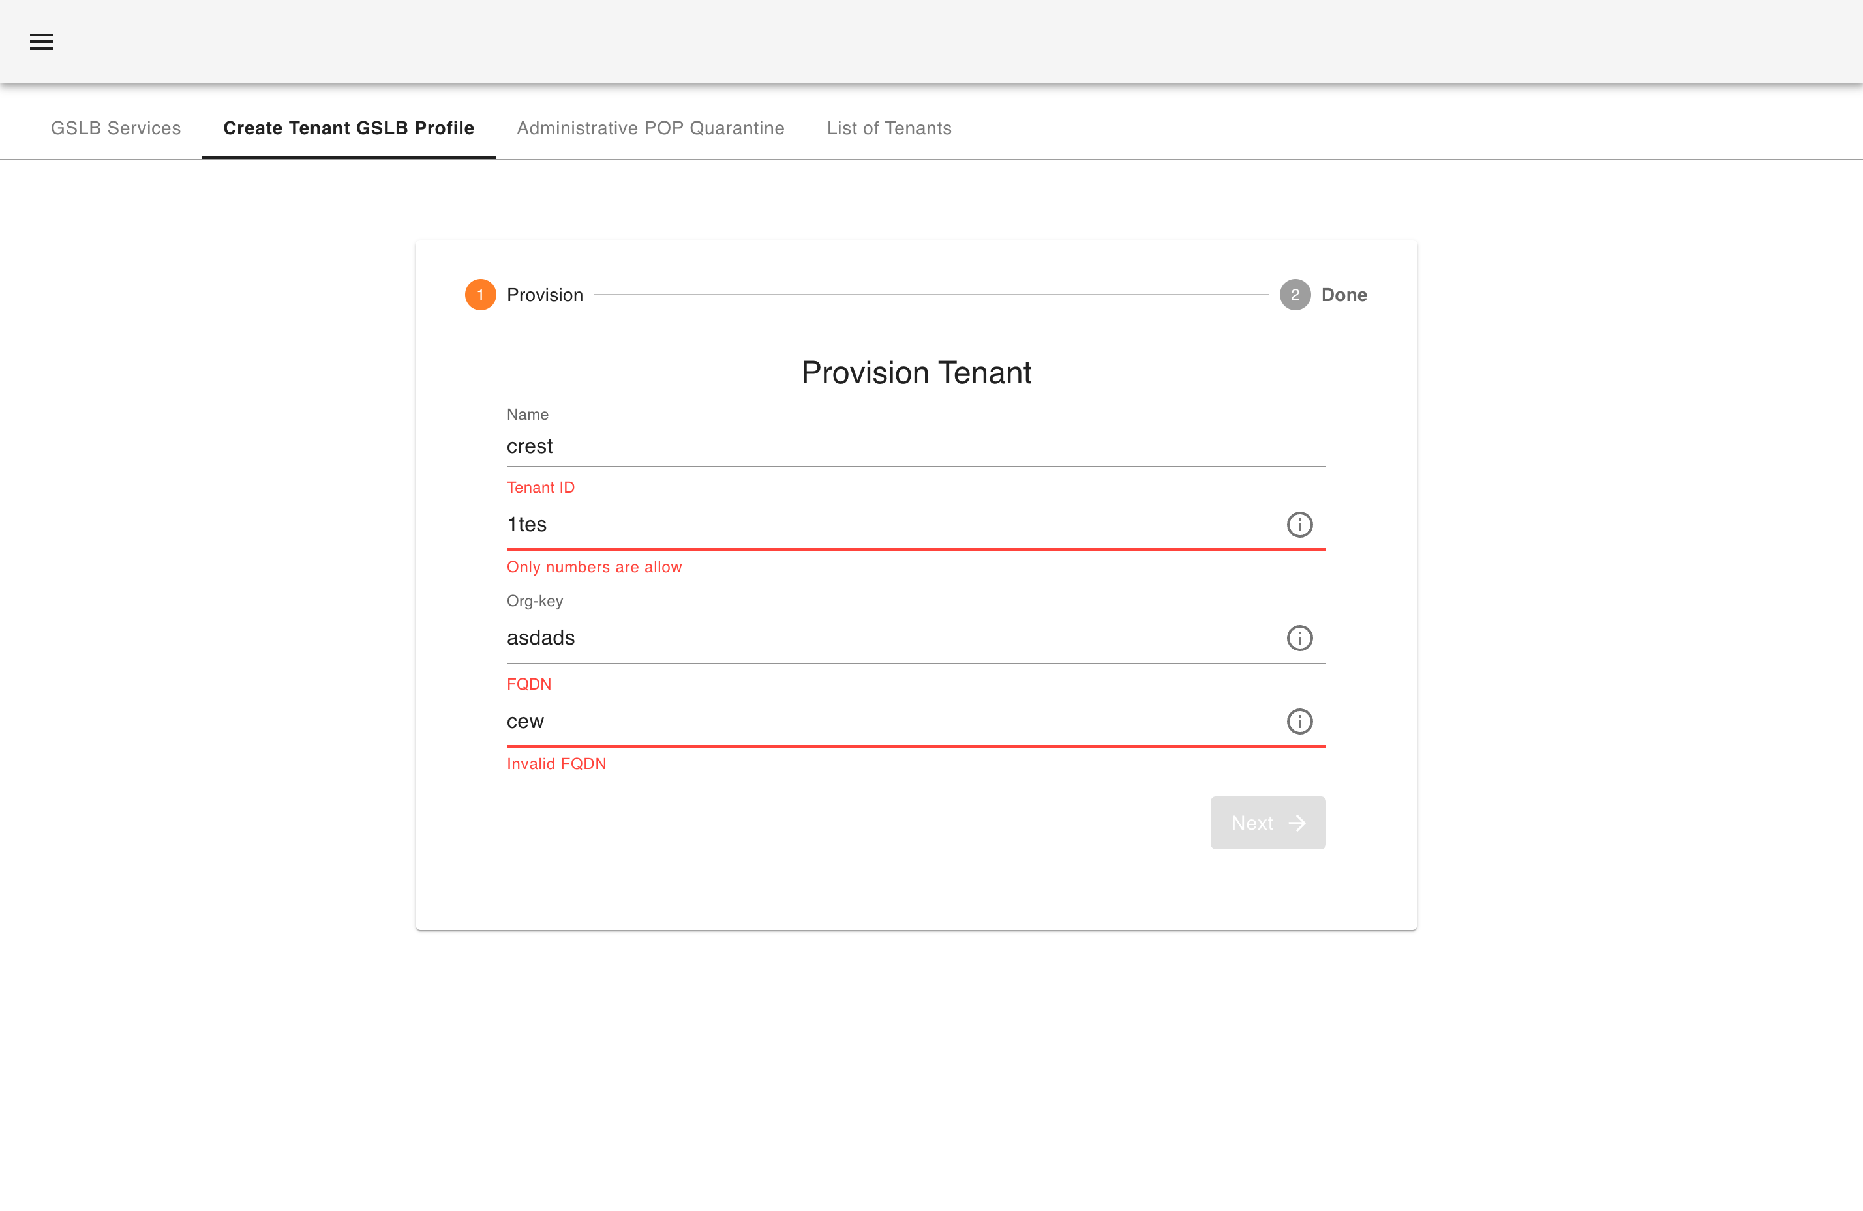
Project Details
Tirth Patel (20BCE223) B.Tech 8th Sem Major Project
Cloud Security Platform

Slide 13
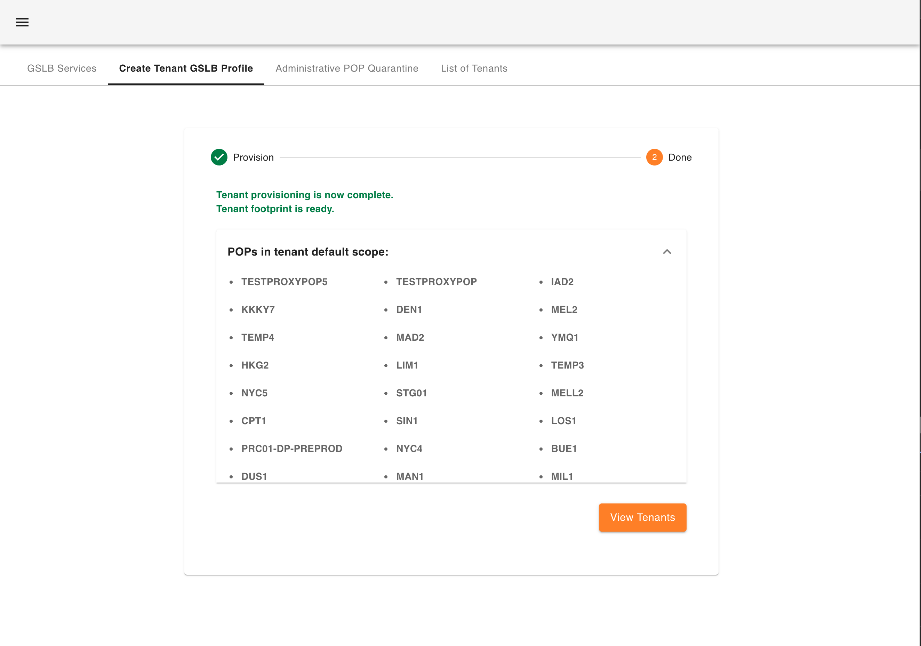
Project Details
Tirth Patel (20BCE223) B.Tech 8th Sem Major Project
Cloud Security Platform

Slide 14
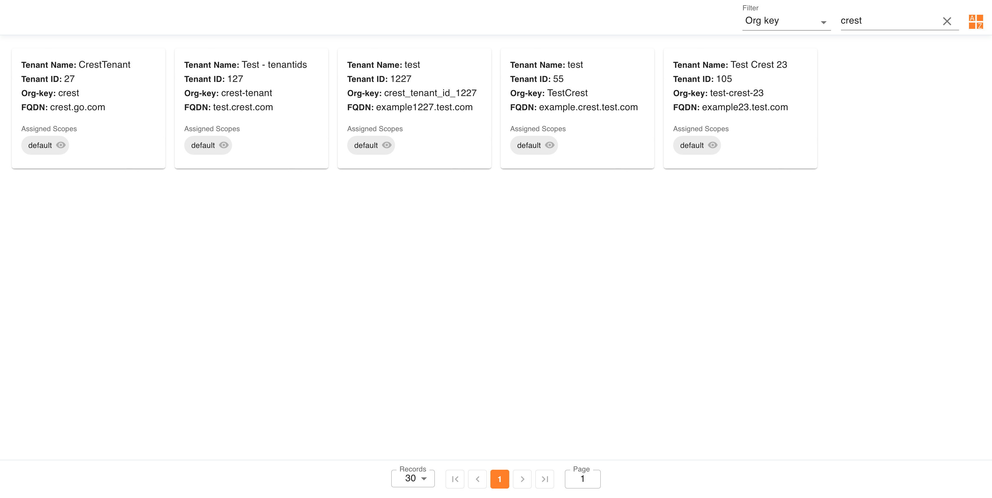
Project Details
Tirth Patel (20BCE223) B.Tech 8th Sem Major Project
Cloud Security Platform

Slide 15
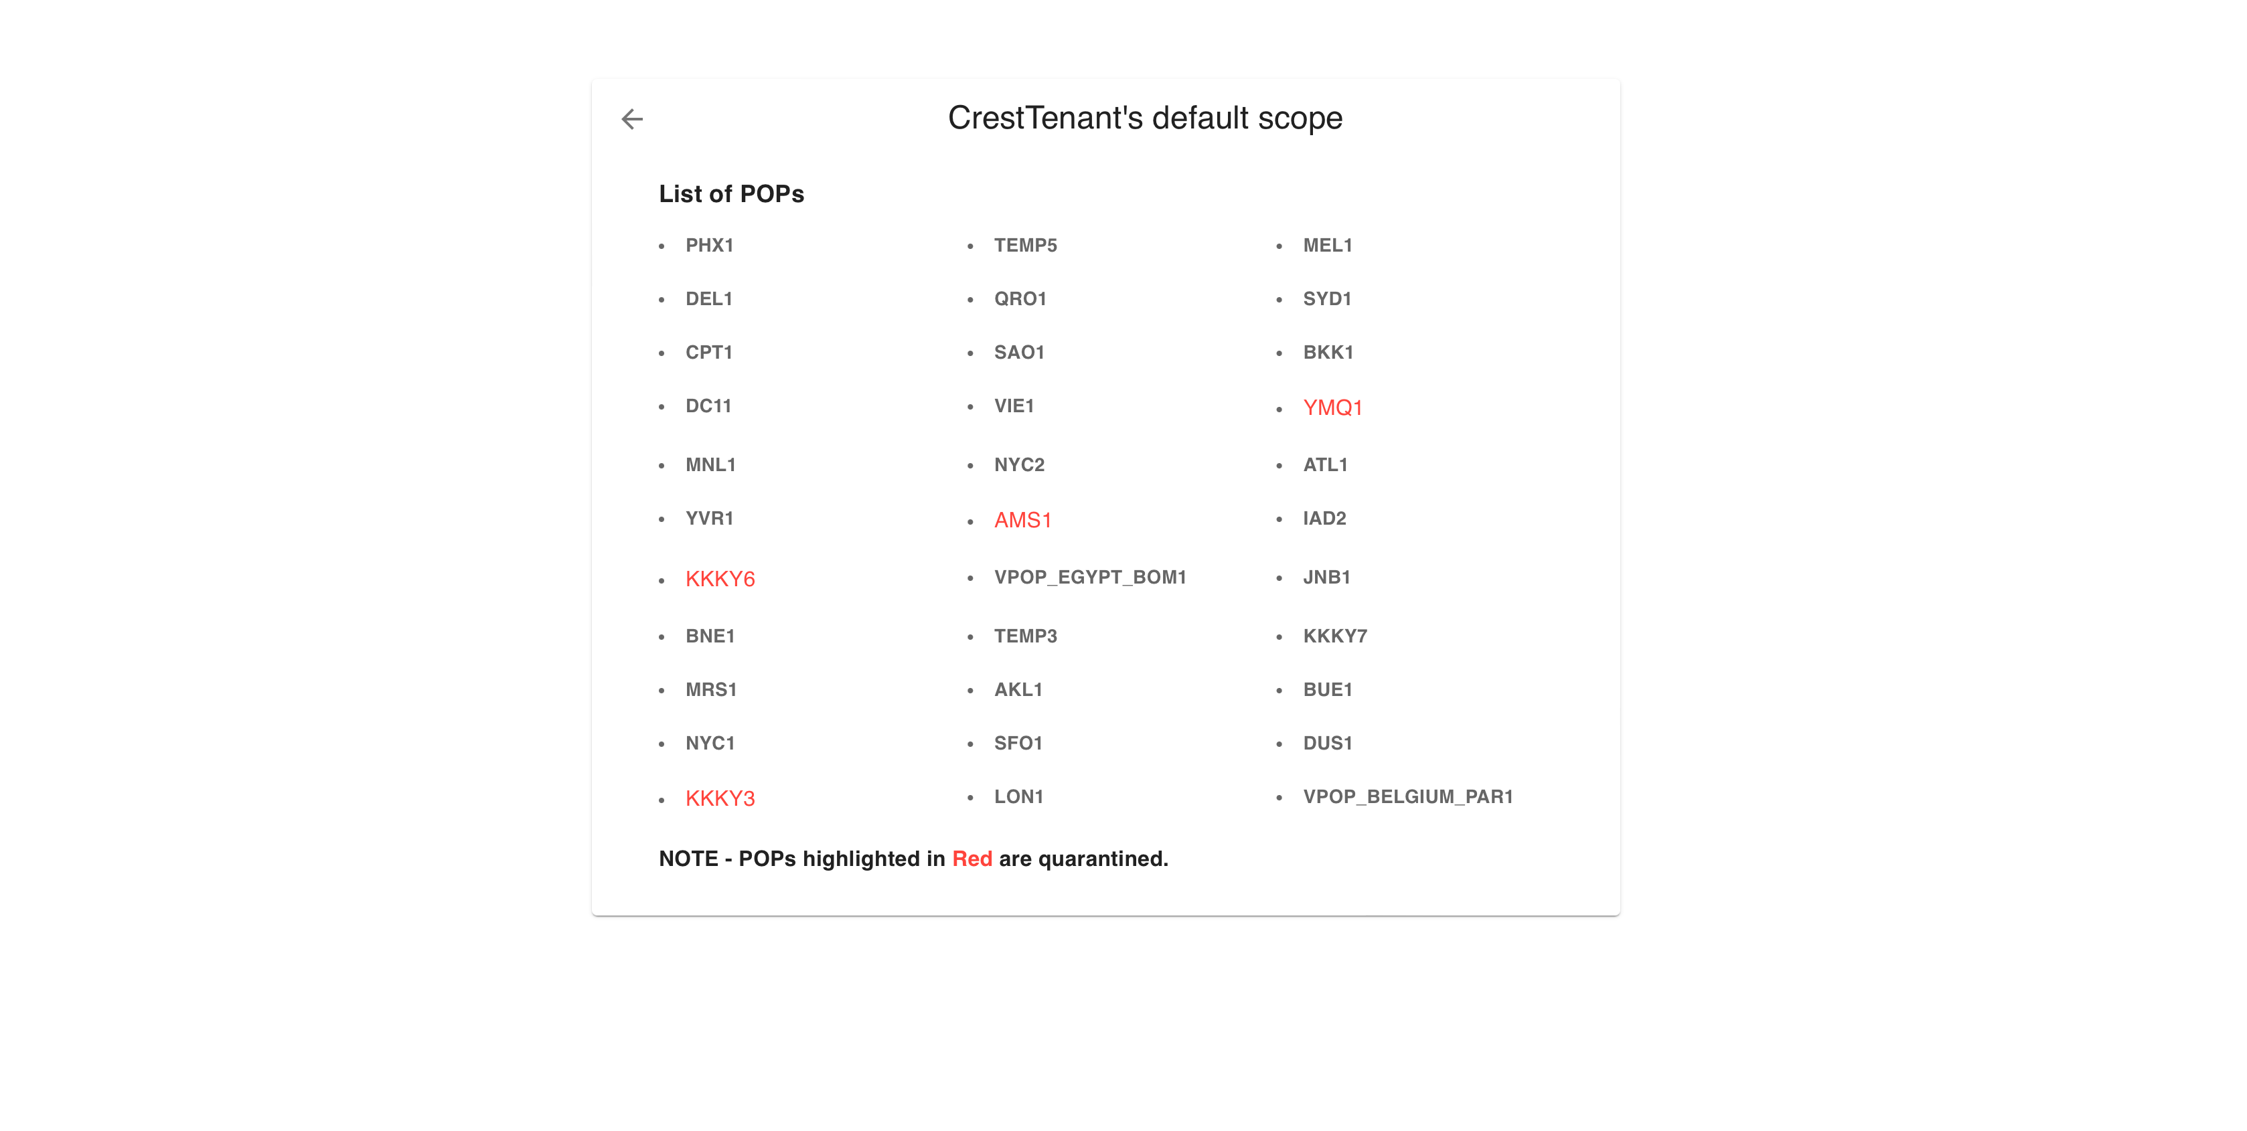
Project Details
Tirth Patel (20BCE223) B.Tech 8th Sem Major Project
Cloud Security Platform

Slide 16
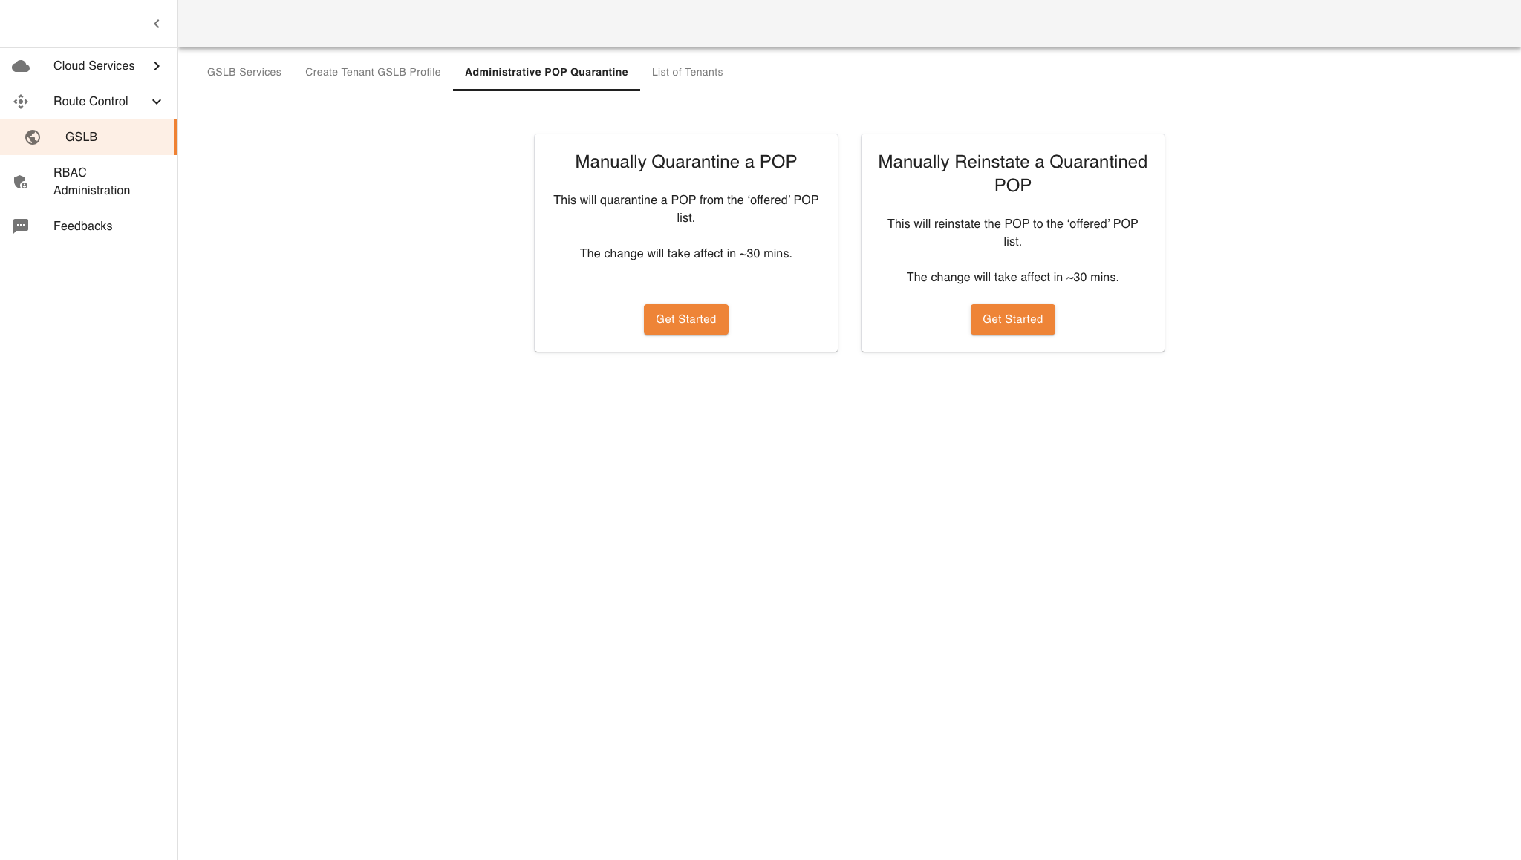
Project Details
Tirth Patel (20BCE223) B.Tech 8th Sem Major Project
Cloud Security Platform

Slide 17
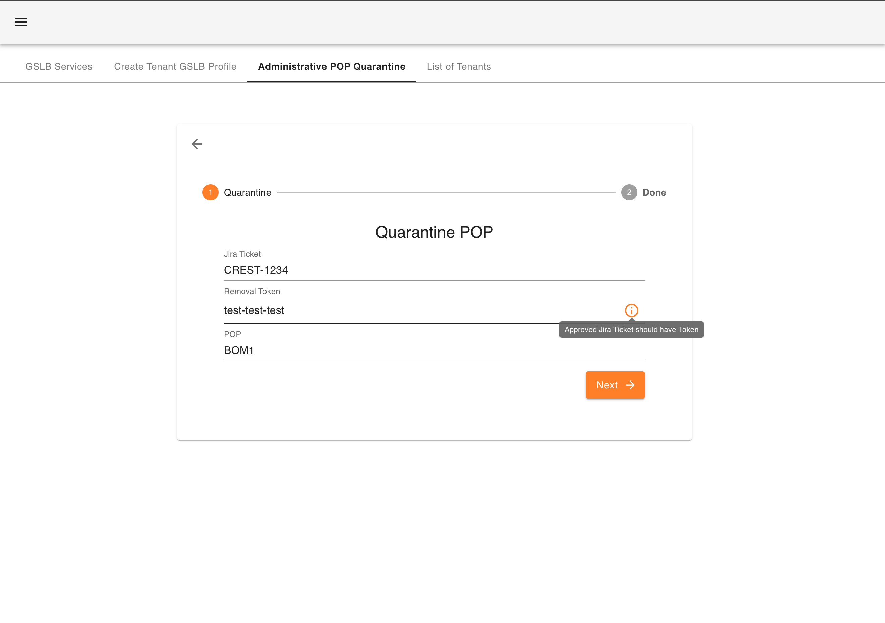
Project Details
Tirth Patel (20BCE223) B.Tech 8th Sem Major Project
Cloud Security Platform

Slide 18
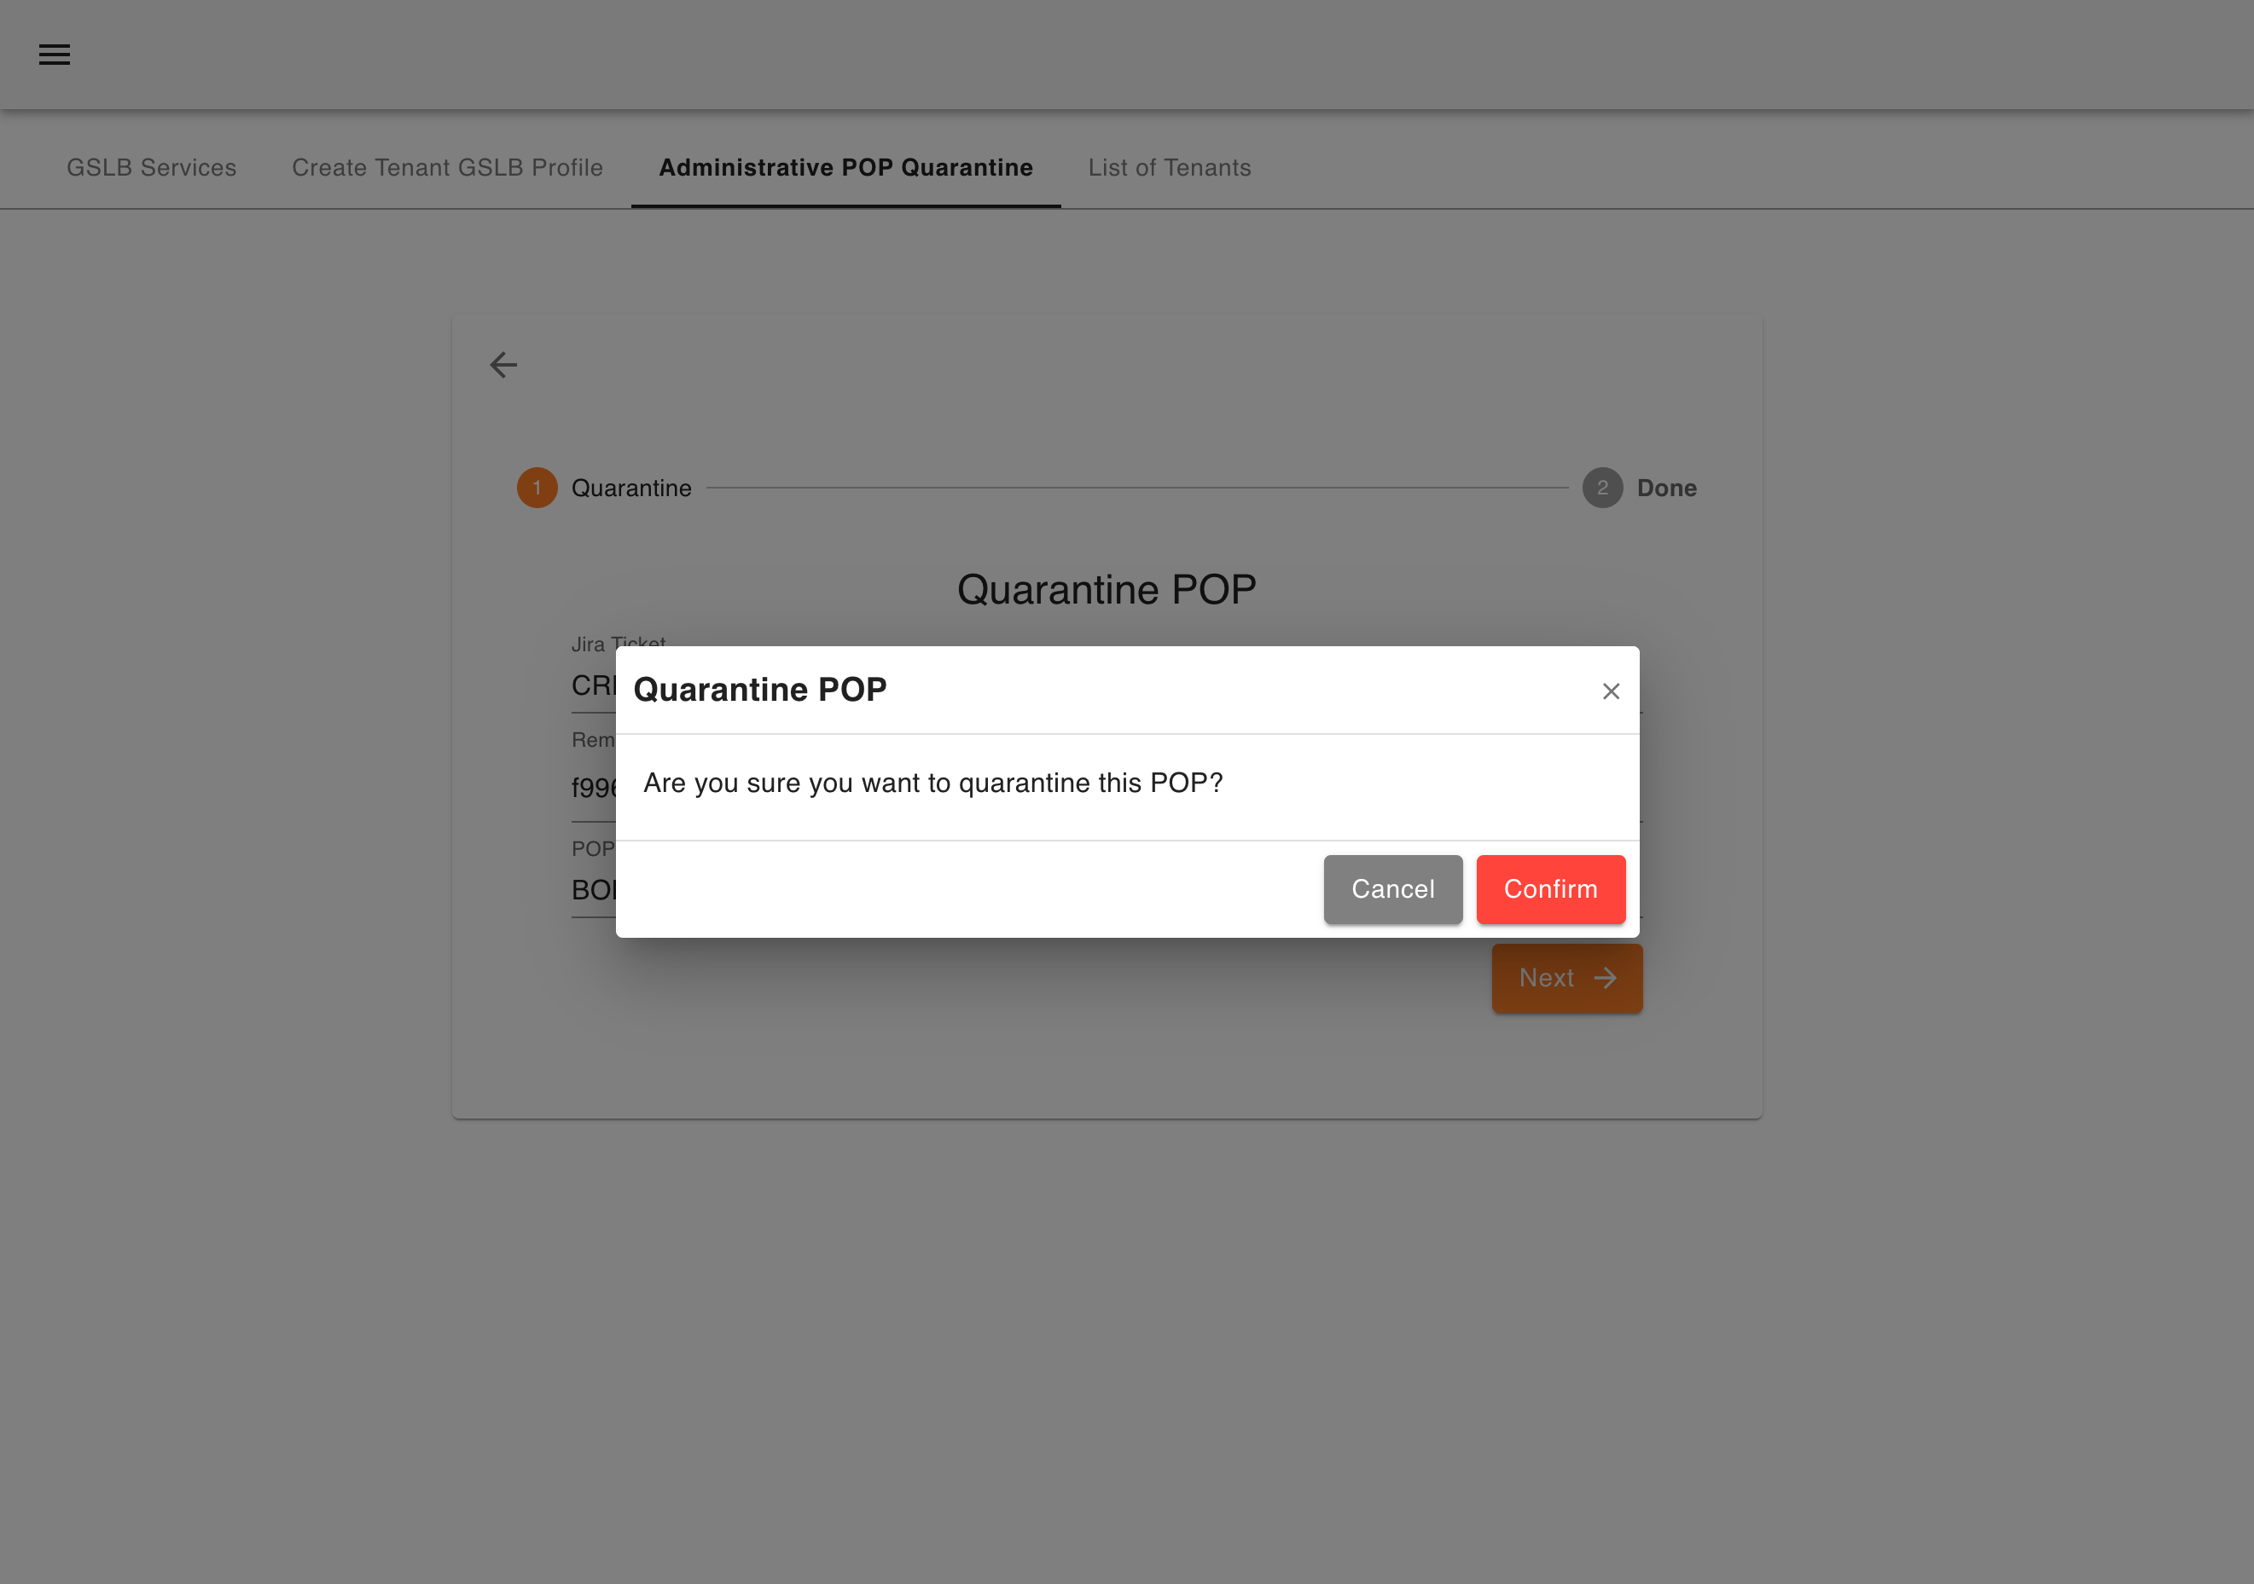
Project Details
Tirth Patel (20BCE223) B.Tech 8th Sem Major Project
Cloud Security Platform

Slide 19
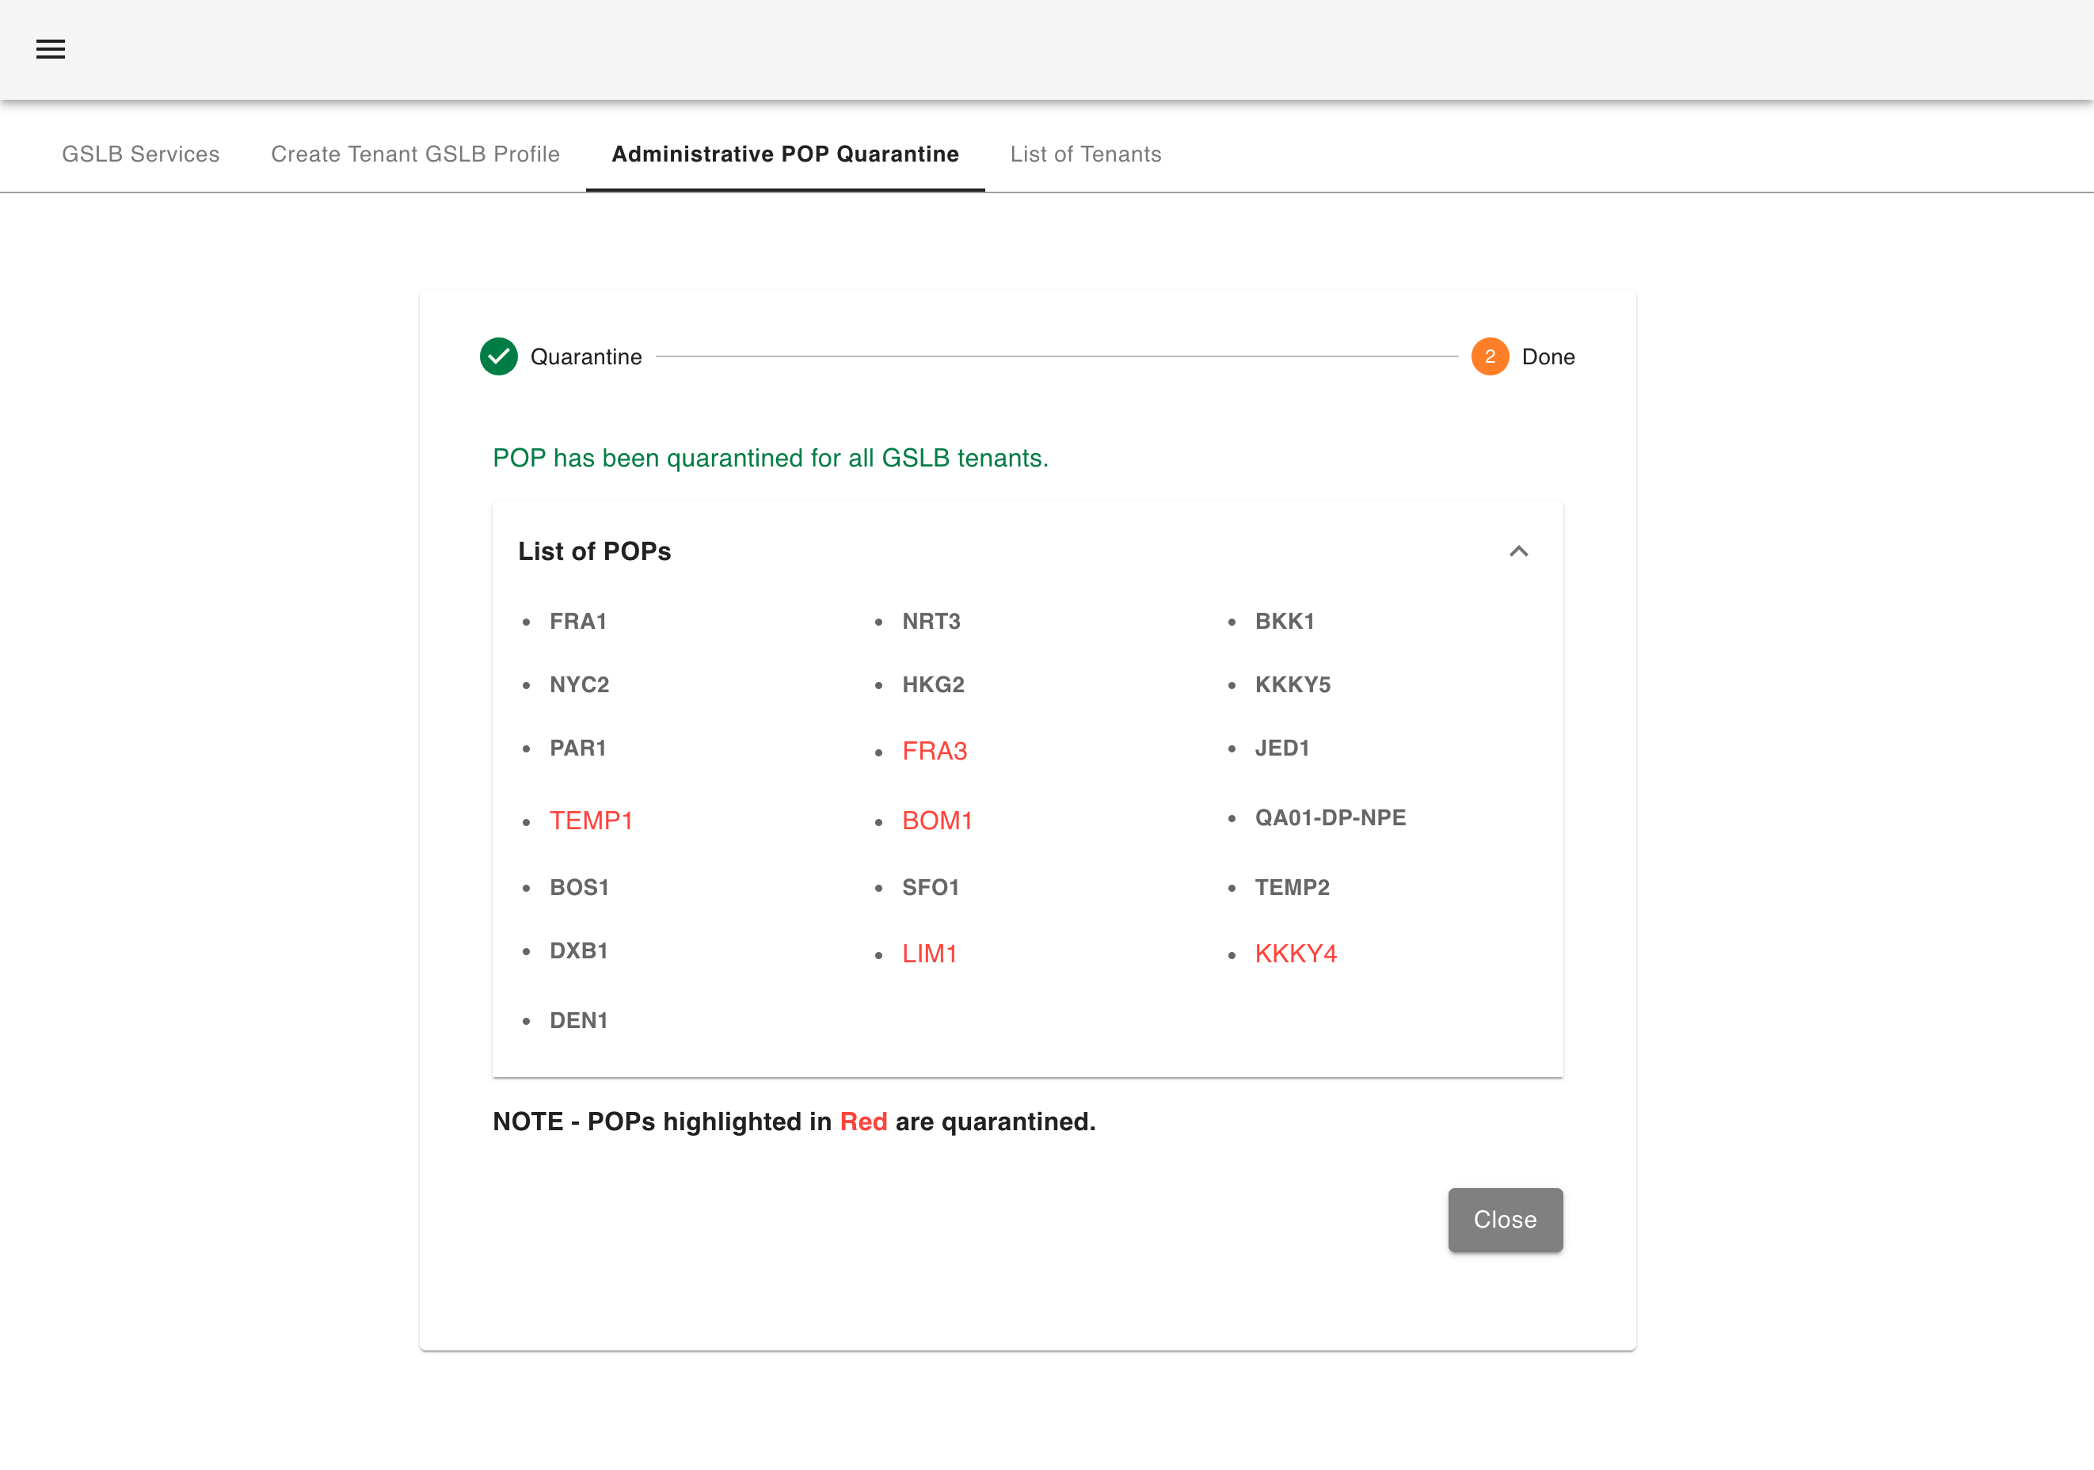
Project Details
Tirth Patel (20BCE223) B.Tech 8th Sem Major Project
Cloud Security Platform

Slide 20
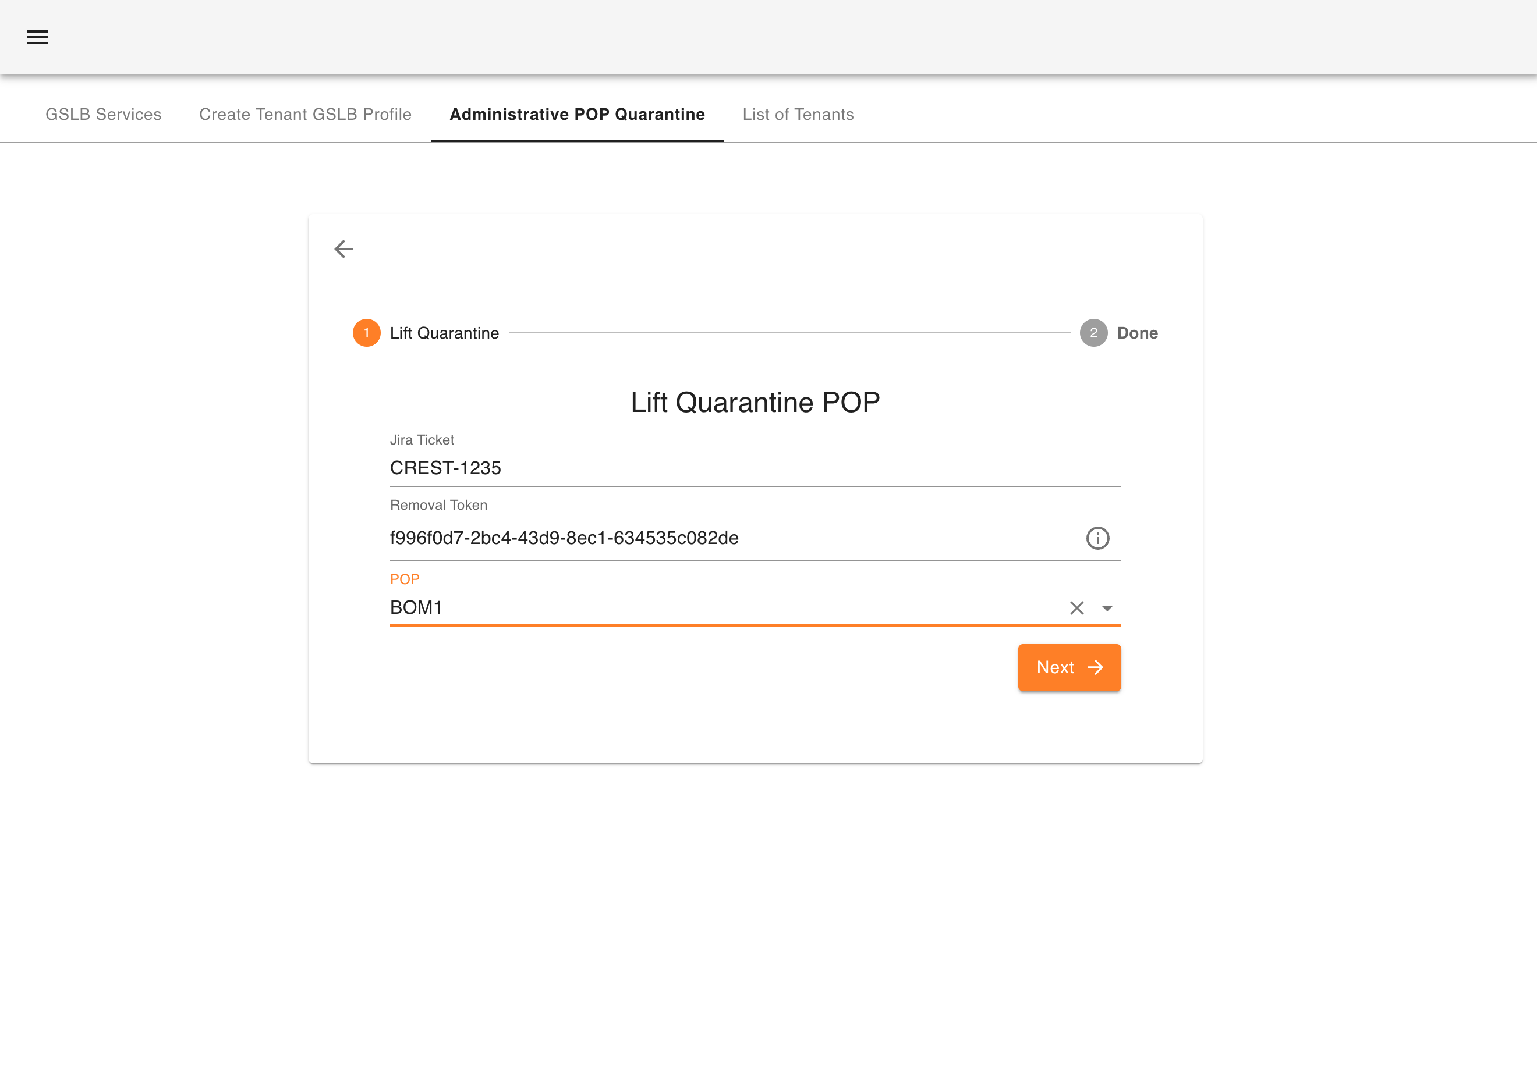
Project Details
Tirth Patel (20BCE223) B.Tech 8th Sem Major Project
Cloud Security Platform

Slide 21
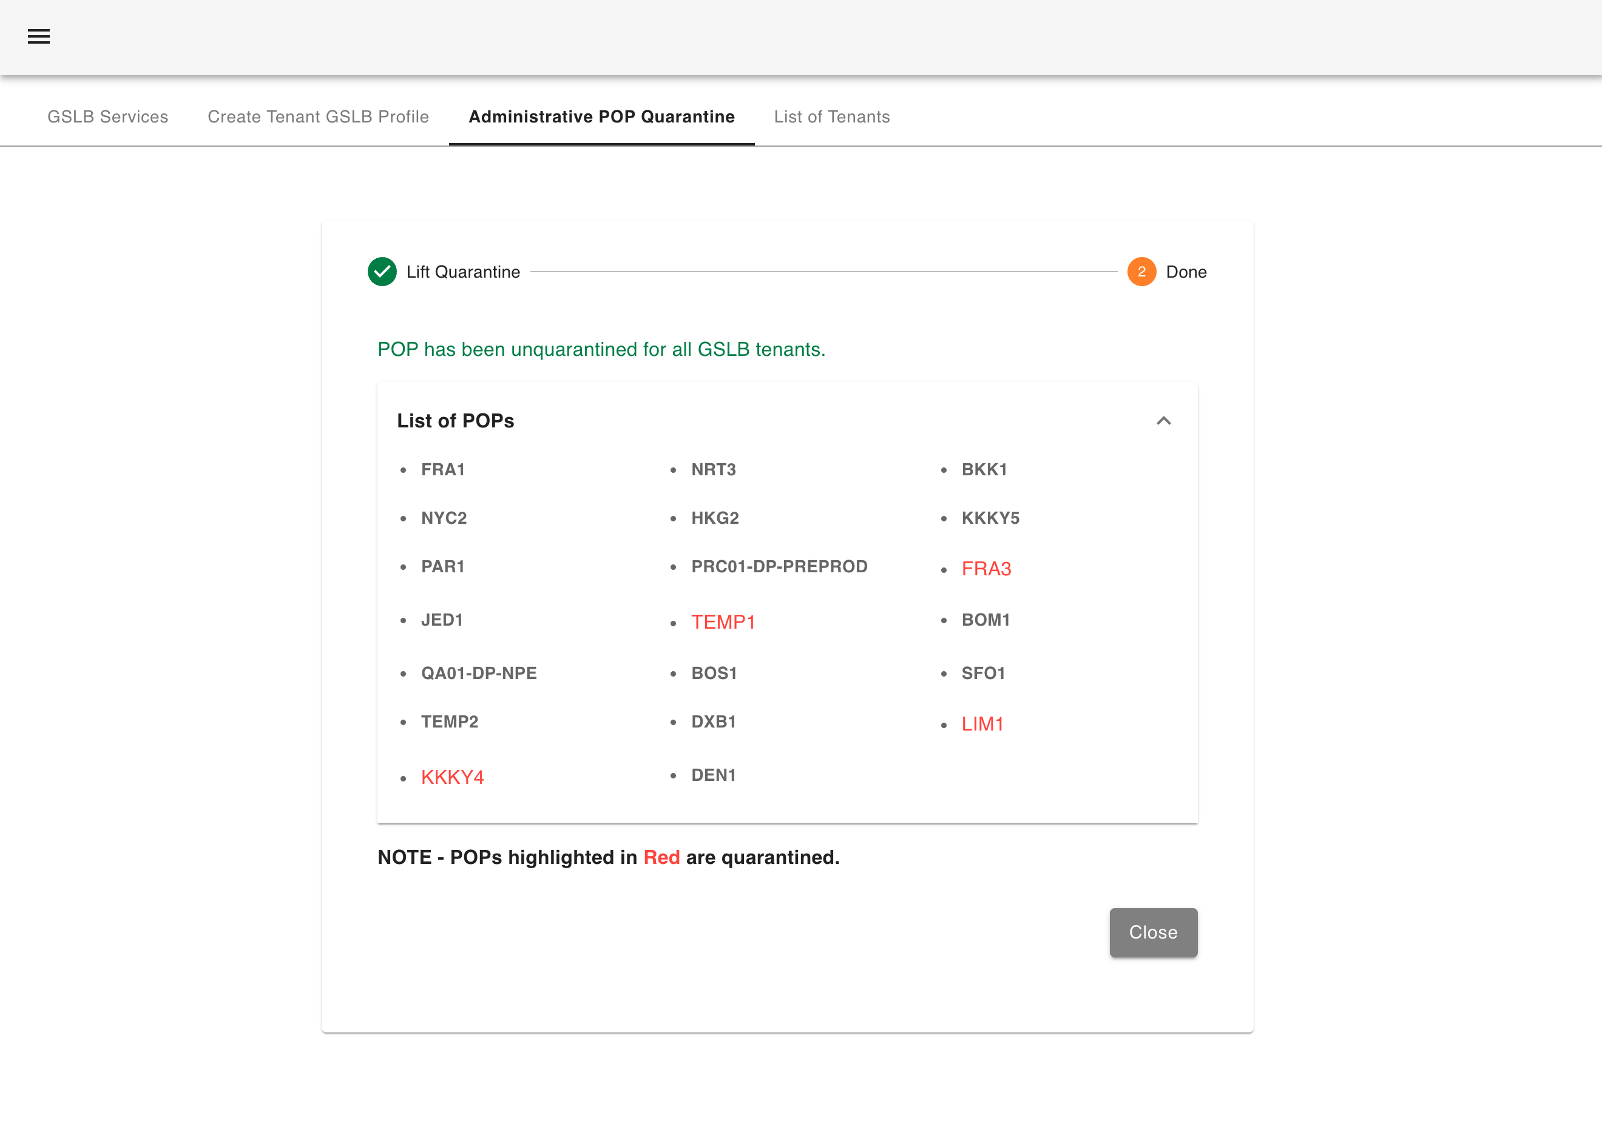
Project Details
Tirth Patel (20BCE223) B.Tech 8th Sem Major Project
Cloud Security Platform

Slide 22
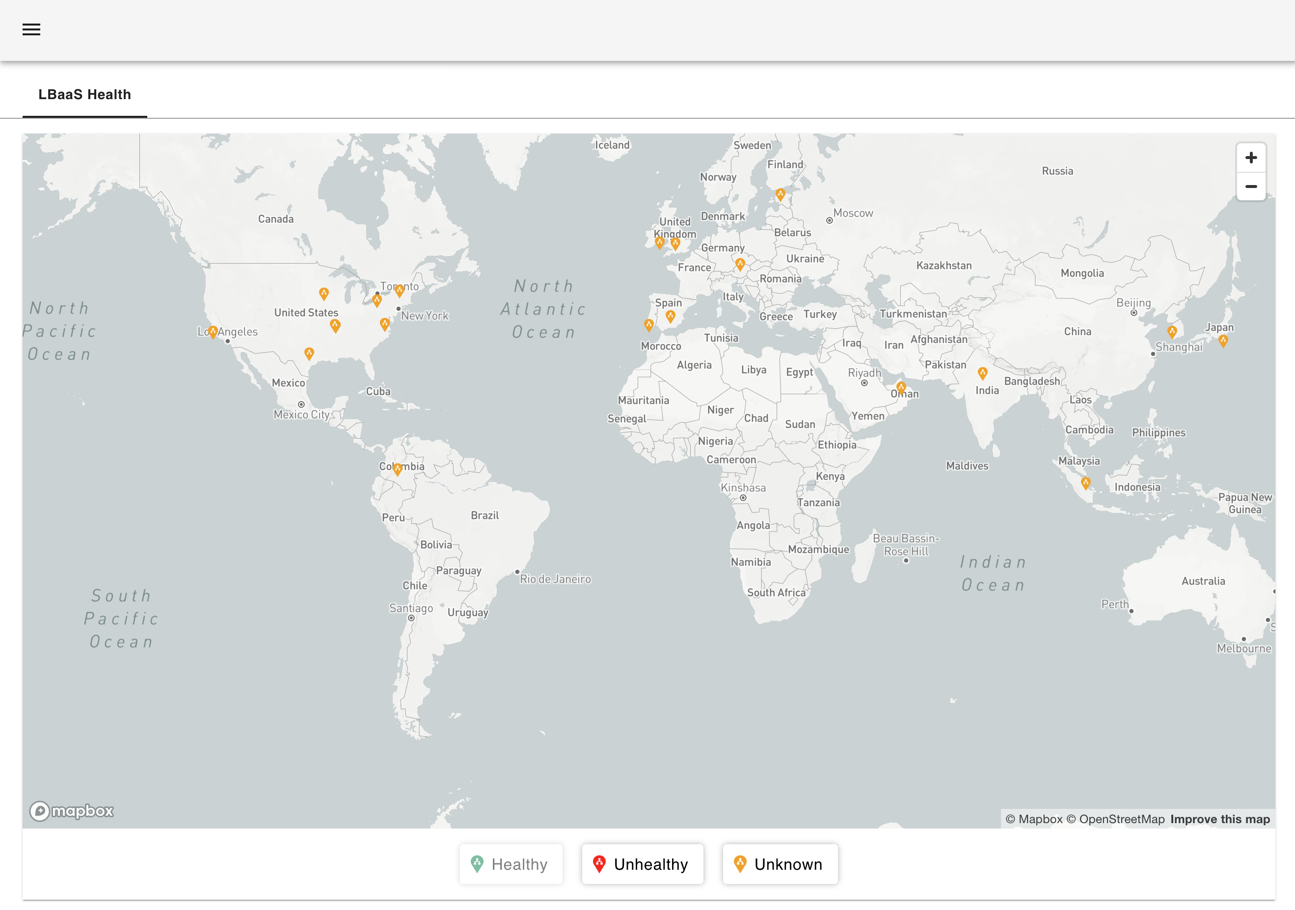
Project Details
Tirth Patel (20BCE223) B.Tech 8th Sem Major Project
Cloud Security Platform

Slide 23
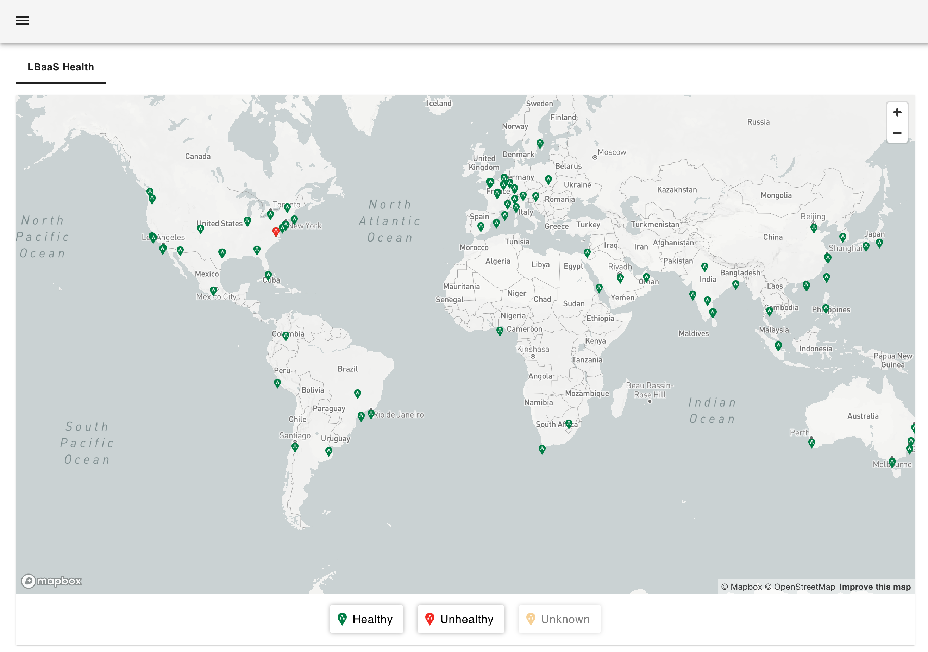
Project Details
Tirth Patel (20BCE223) B.Tech 8th Sem Major Project
Cloud Security Platform

Slide 24
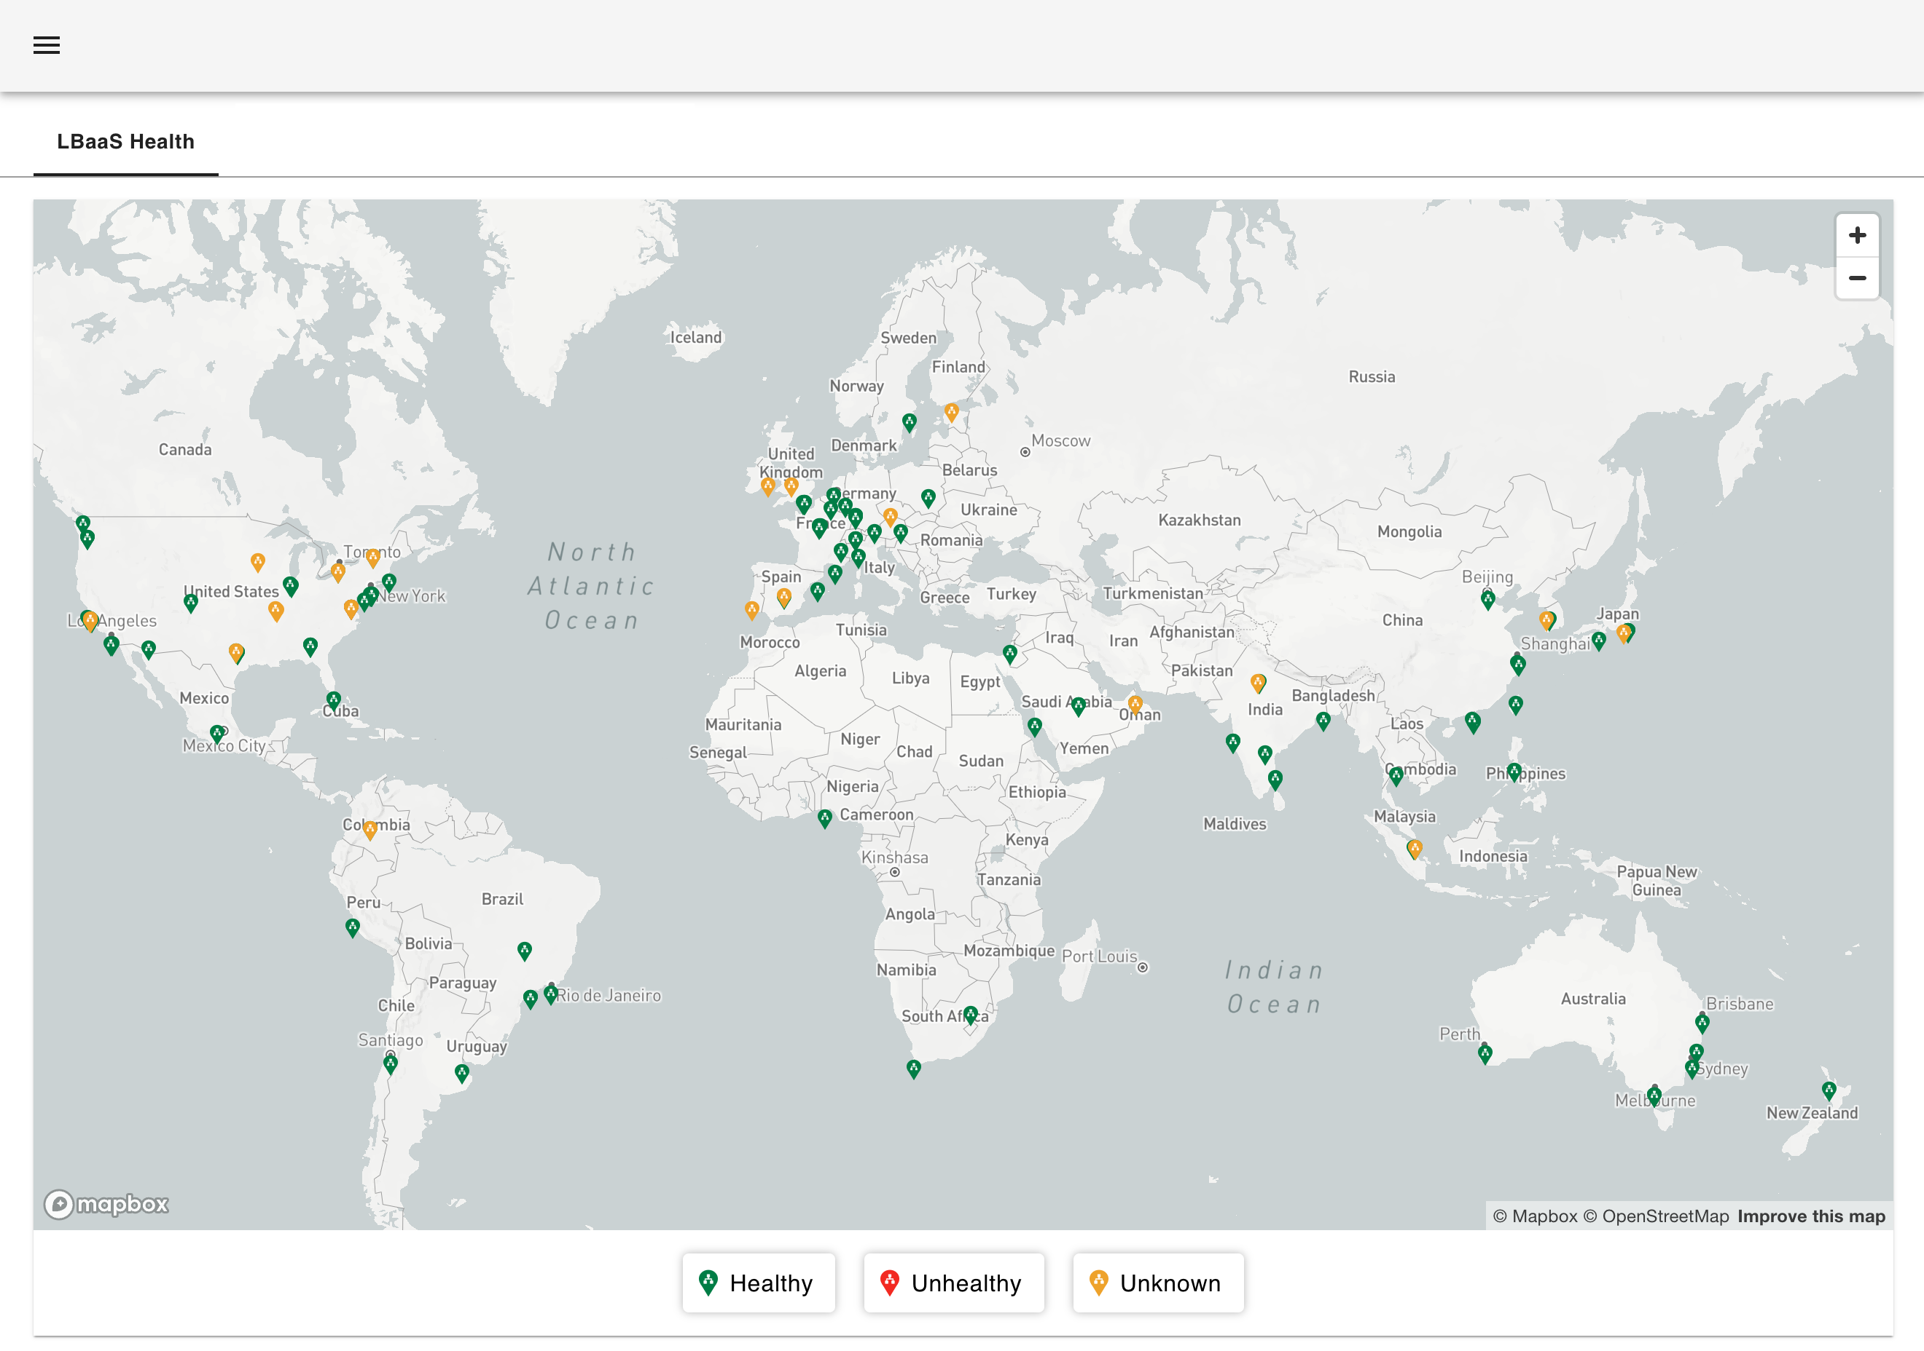
Project Details
Tirth Patel (20BCE223) B.Tech 8th Sem Major Project
Cloud Security Platform

Slide 25
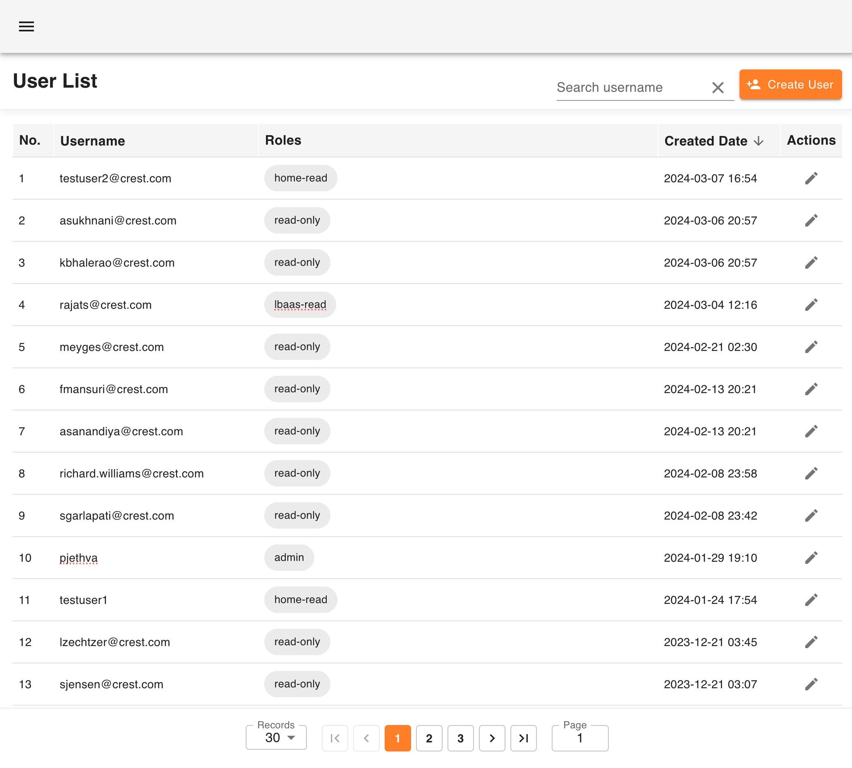
Project Details
Tirth Patel (20BCE223) B.Tech 8th Sem Major Project
Cloud Security Platform

Slide 26
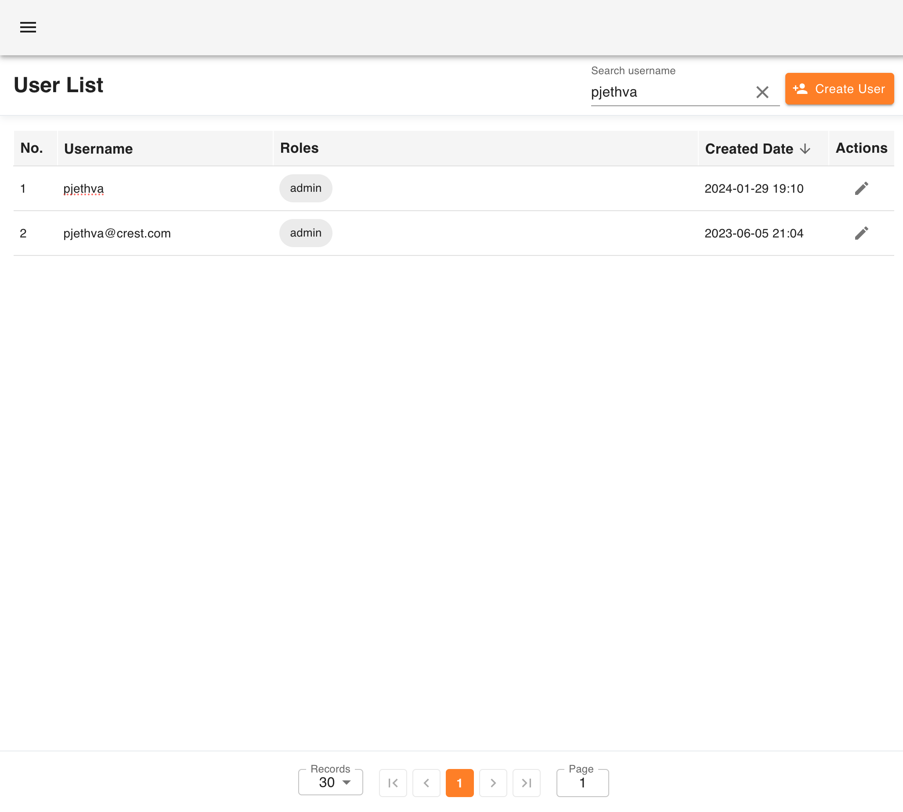
Project Details
Tirth Patel (20BCE223) B.Tech 8th Sem Major Project
Cloud Security Platform

Slide 27
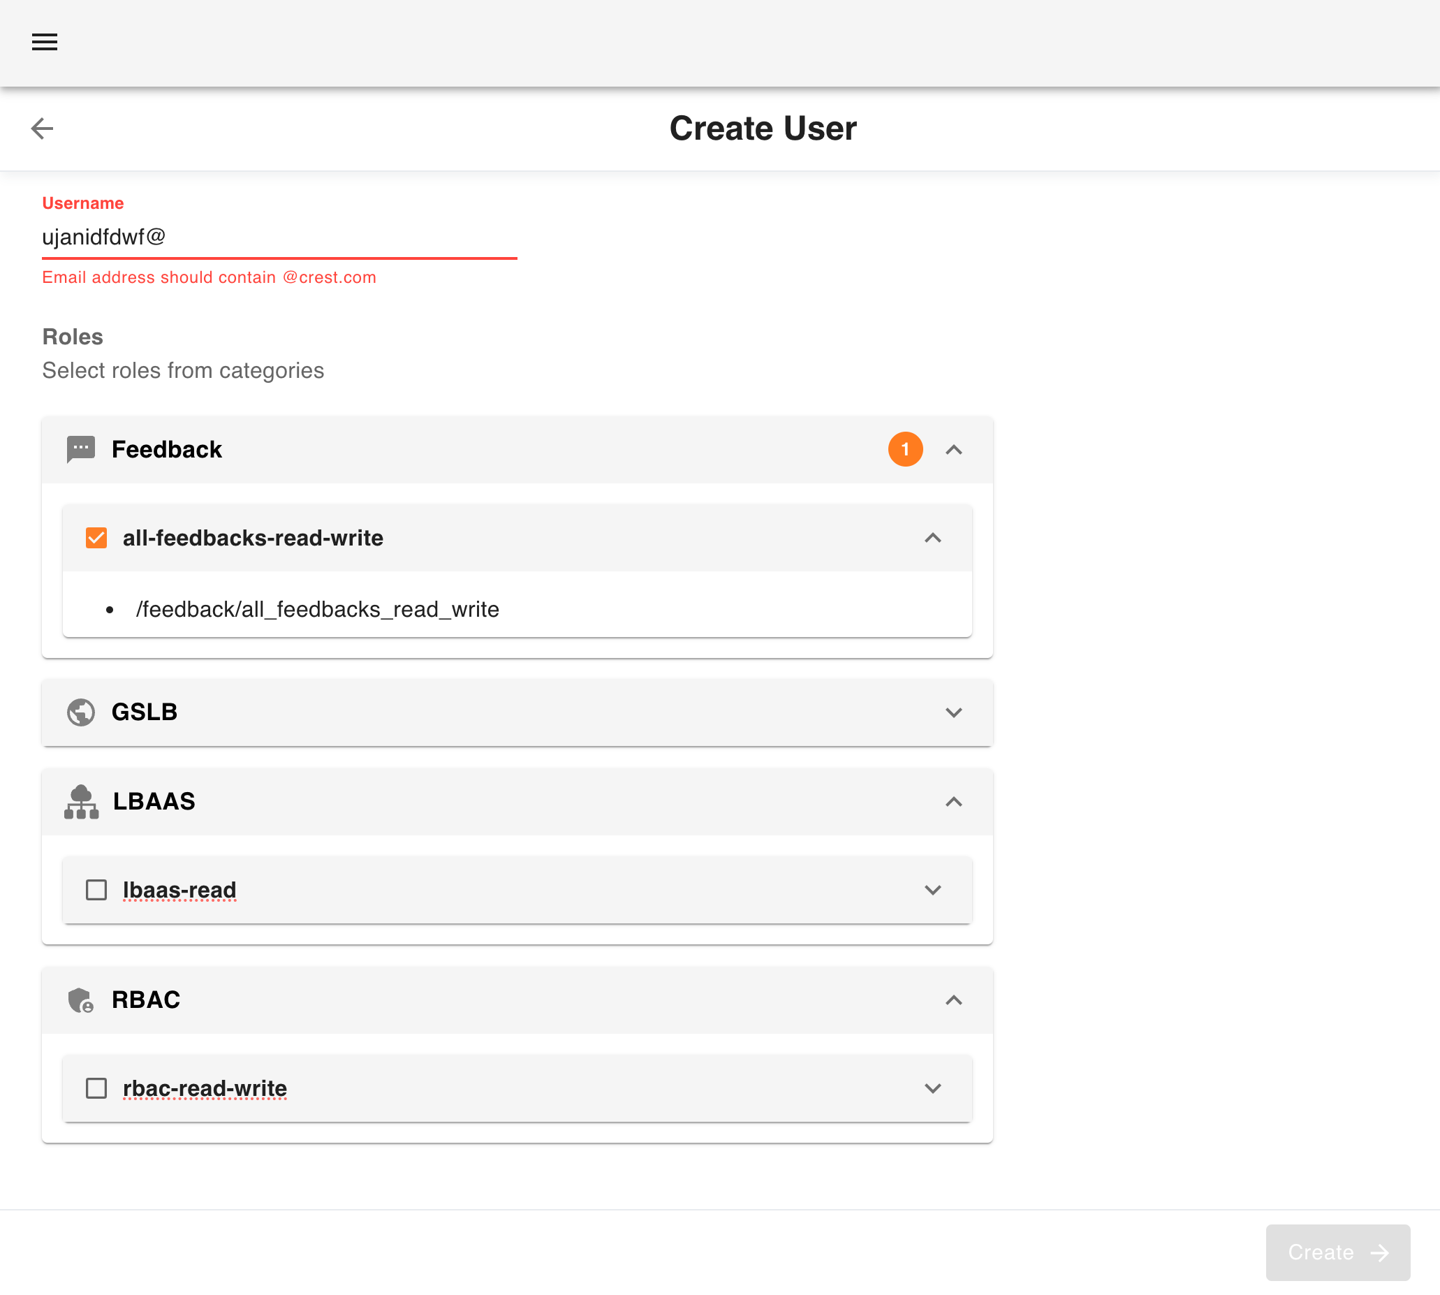
Project Details
Tirth Patel (20BCE223) B.Tech 8th Sem Major Project
Cloud Security Platform

Slide 28
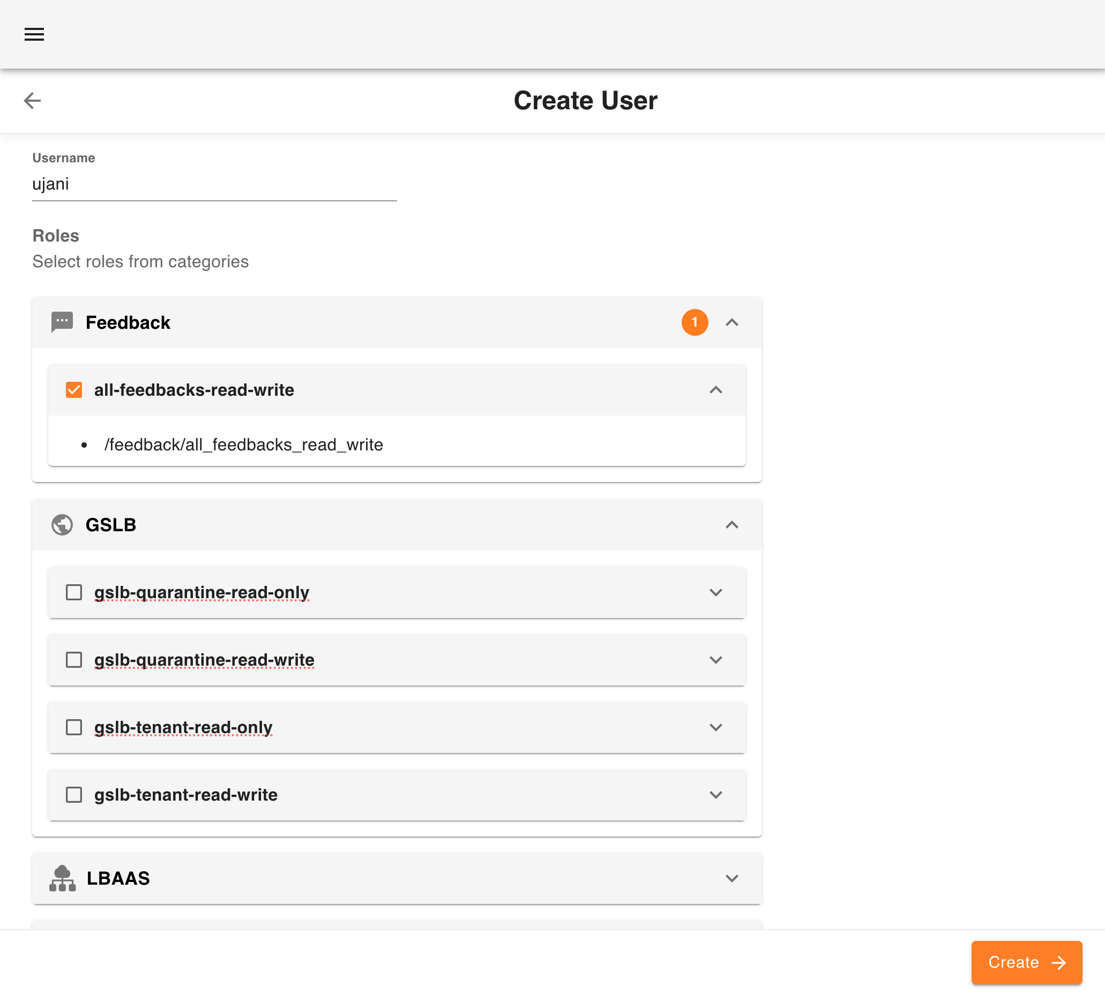
Project Details
Tirth Patel (20BCE223) B.Tech 8th Sem Major Project
Cloud Security Platform

Slide 29
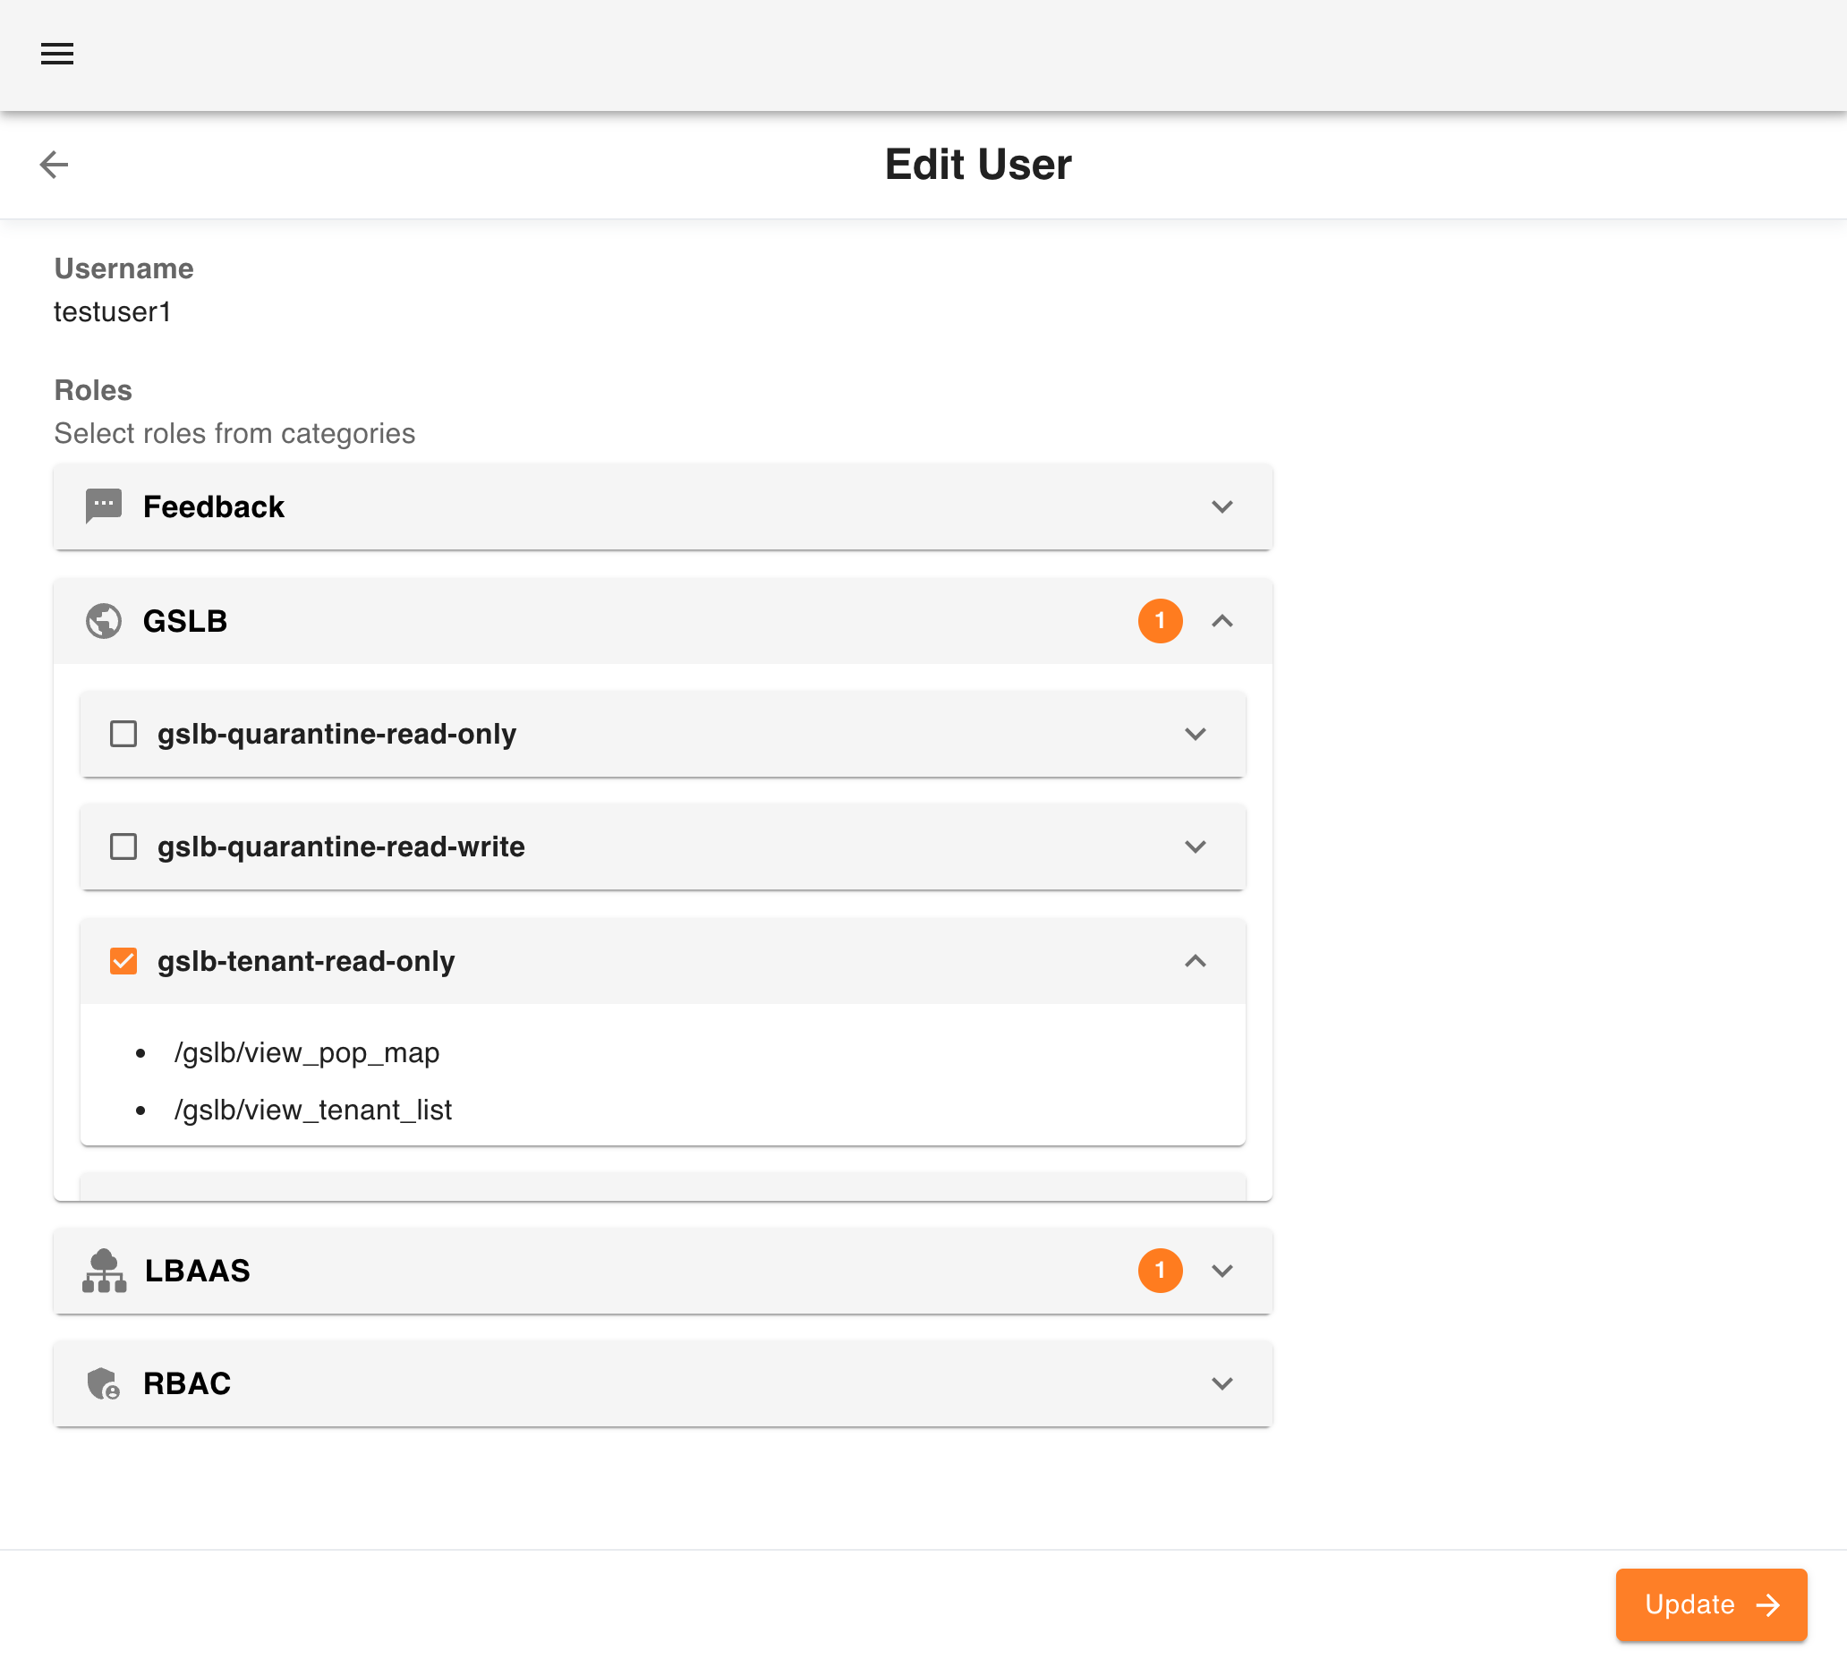
Project Details
Tirth Patel (20BCE223) B.Tech 8th Sem Major Project
Cloud Security Platform

Slide 30
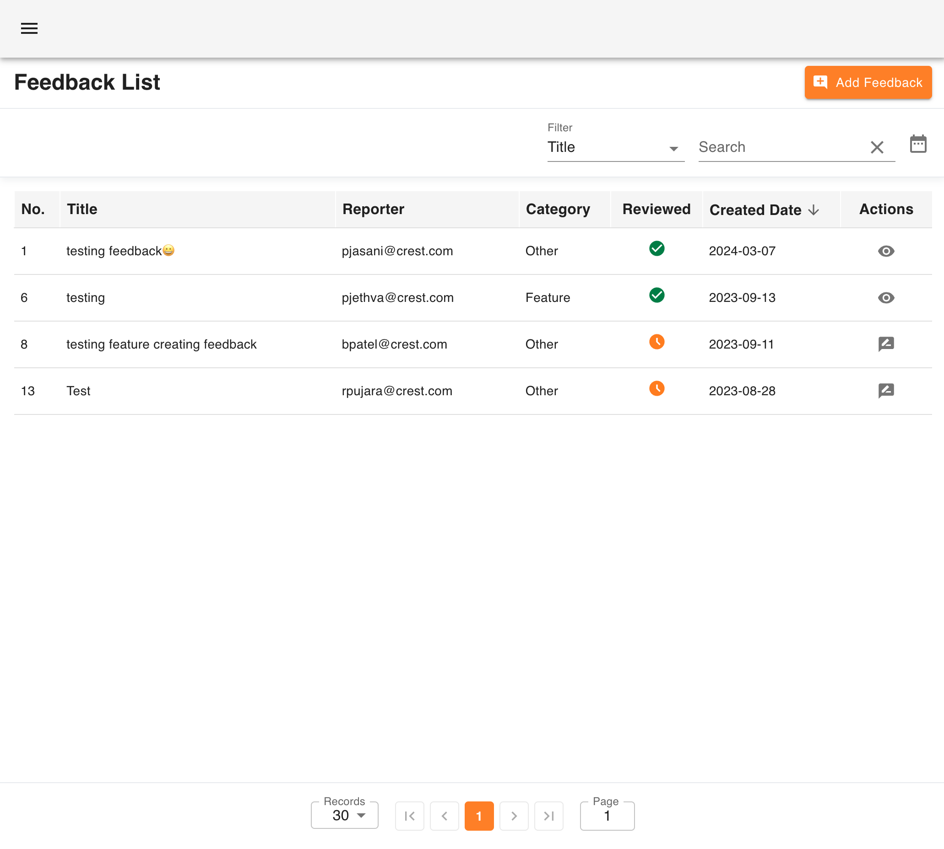
Project Details
Tirth Patel (20BCE223) B.Tech 8th Sem Major Project
Cloud Security Platform

Slide 31
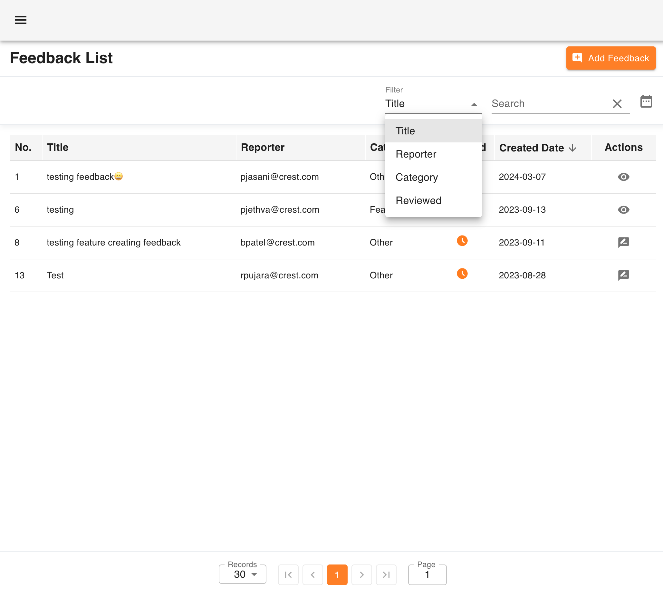
Project Details
Tirth Patel (20BCE223) B.Tech 8th Sem Major Project
Cloud Security Platform

Slide 32
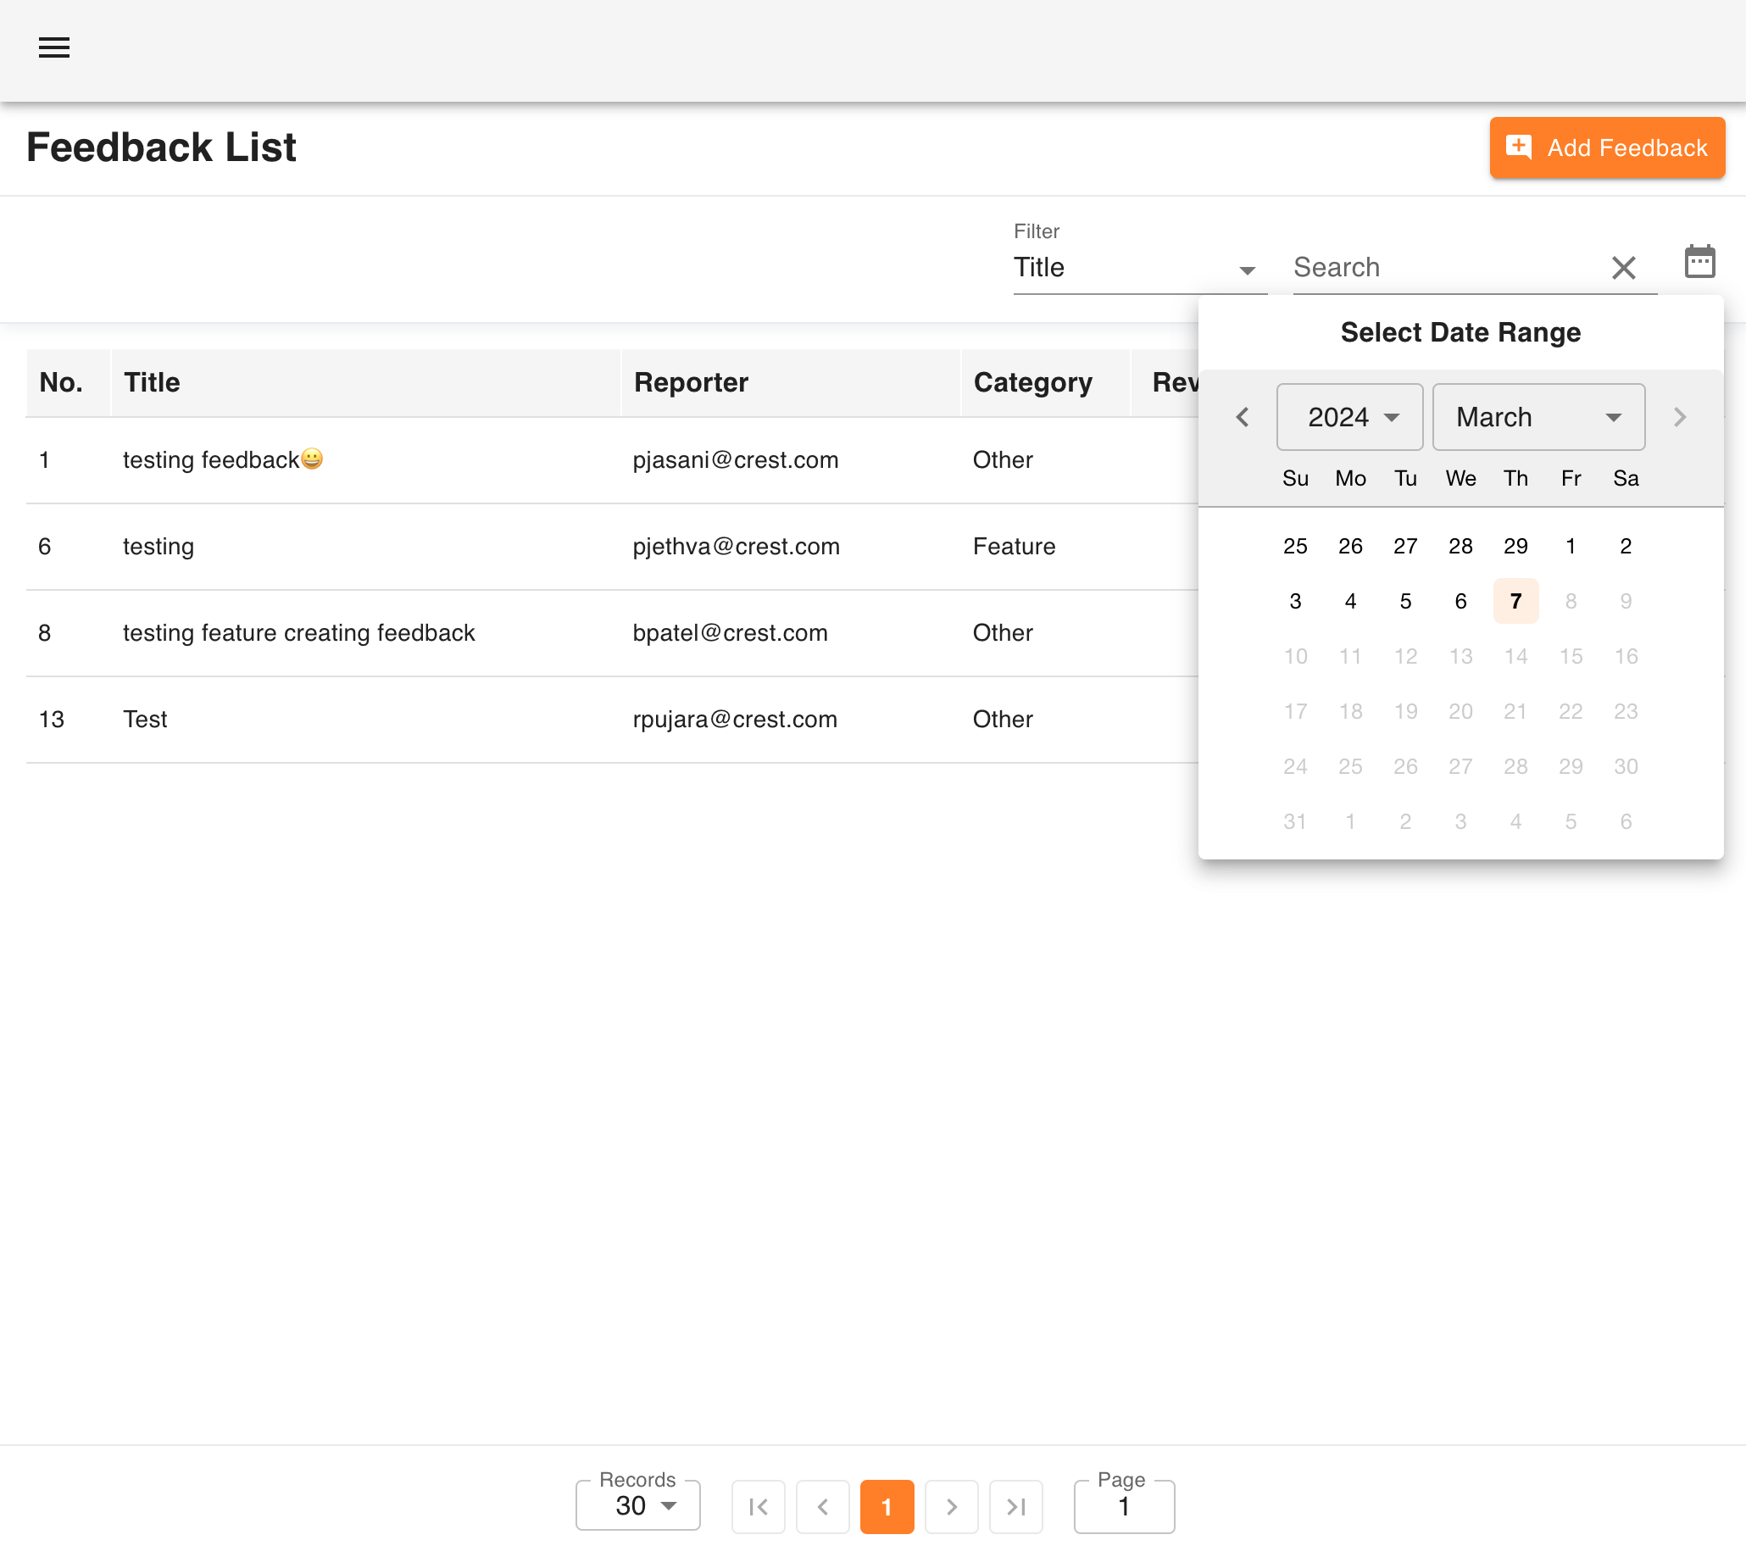
Project Details
Tirth Patel (20BCE223) B.Tech 8th Sem Major Project
Cloud Security Platform

Slide 33
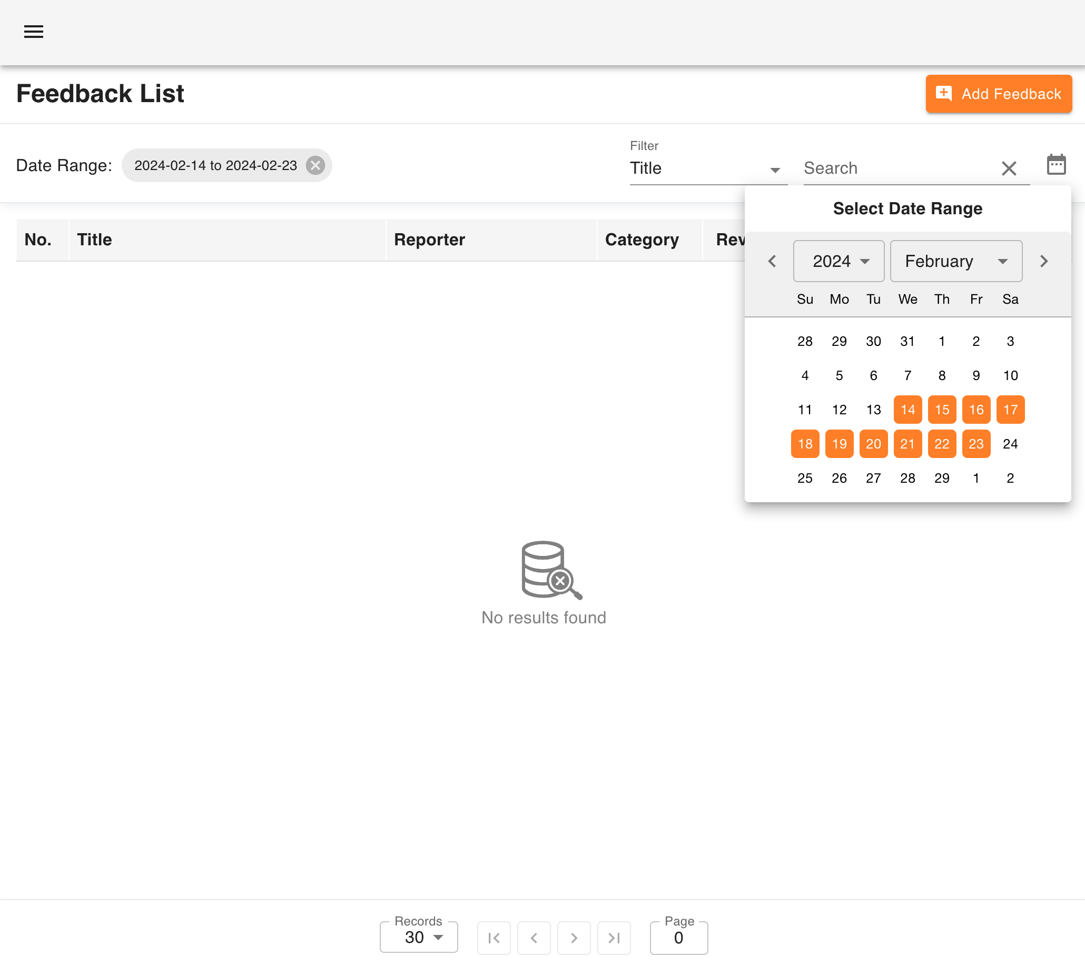
Project Details
Tirth Patel (20BCE223) B.Tech 8th Sem Major Project
Cloud Security Platform

Slide 34
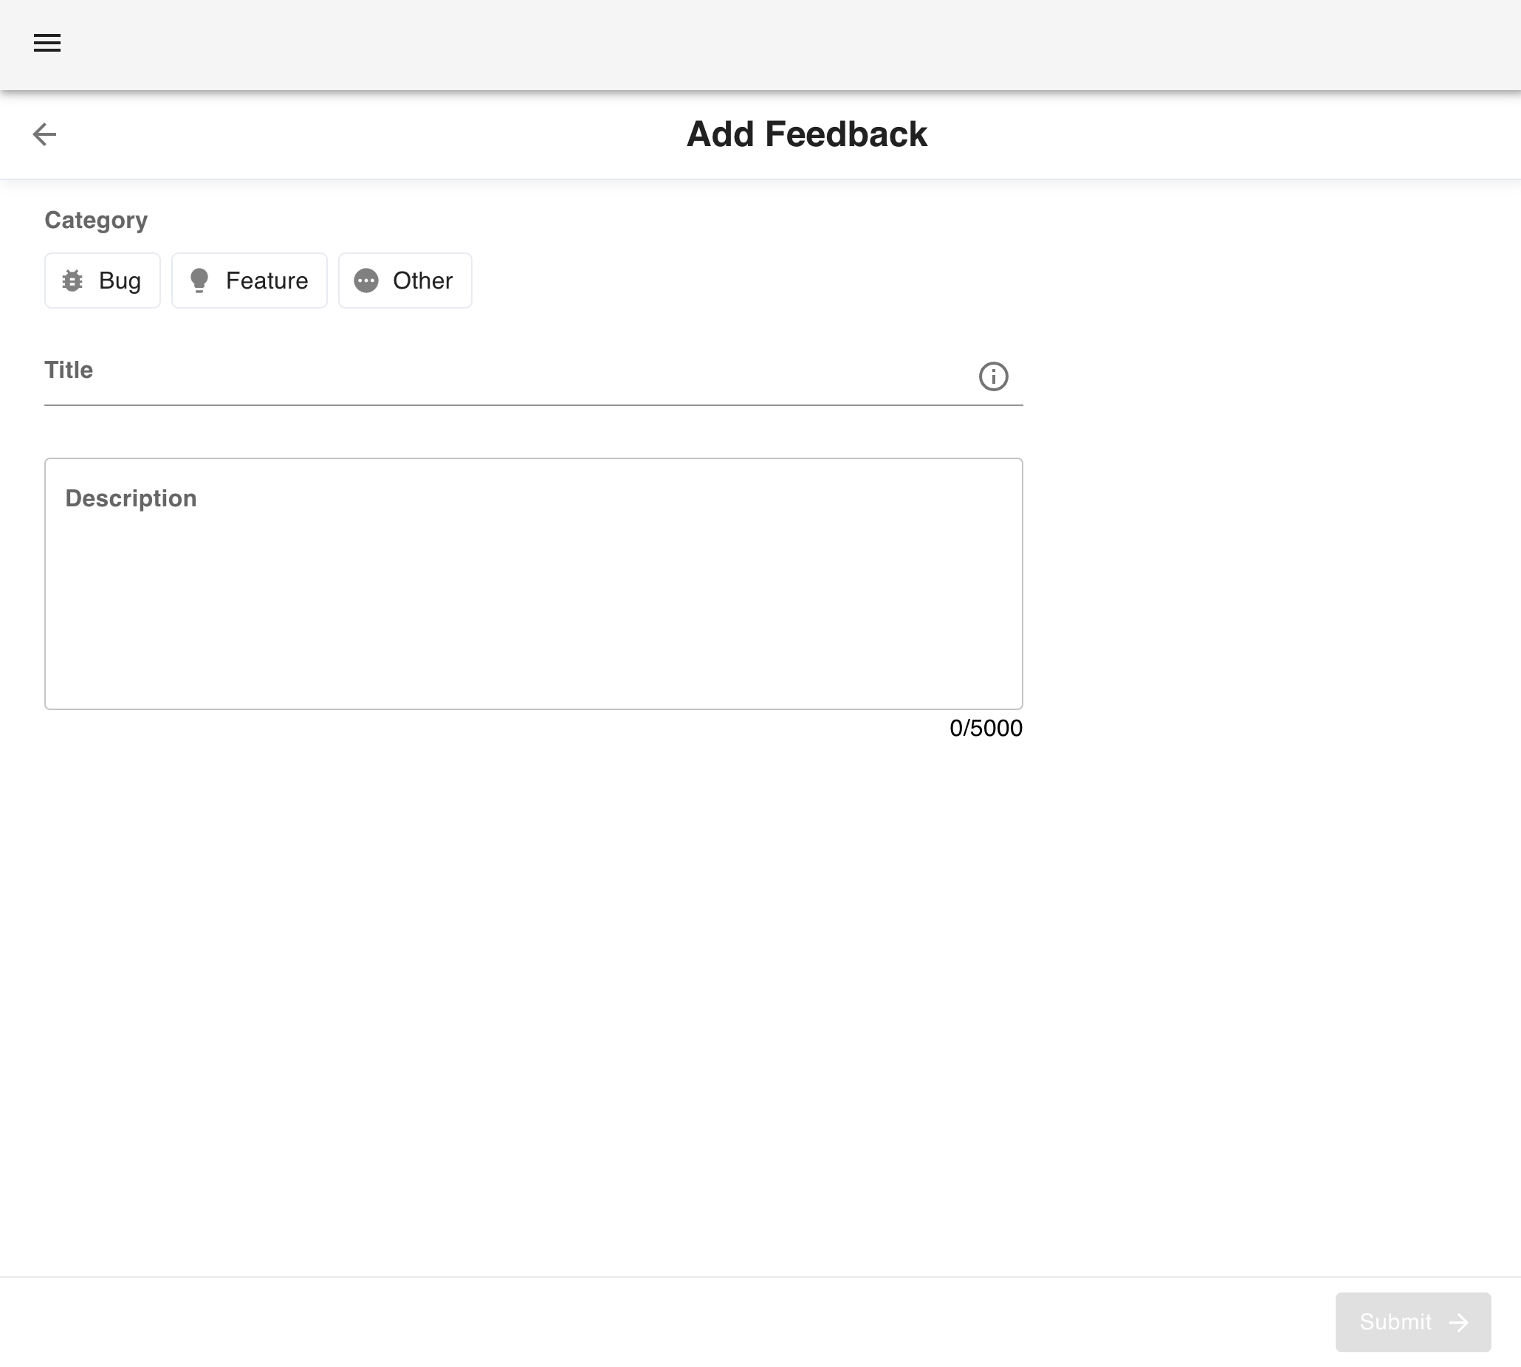
Project Details
Tirth Patel (20BCE223) B.Tech 8th Sem Major Project
Cloud Security Platform

Slide 35
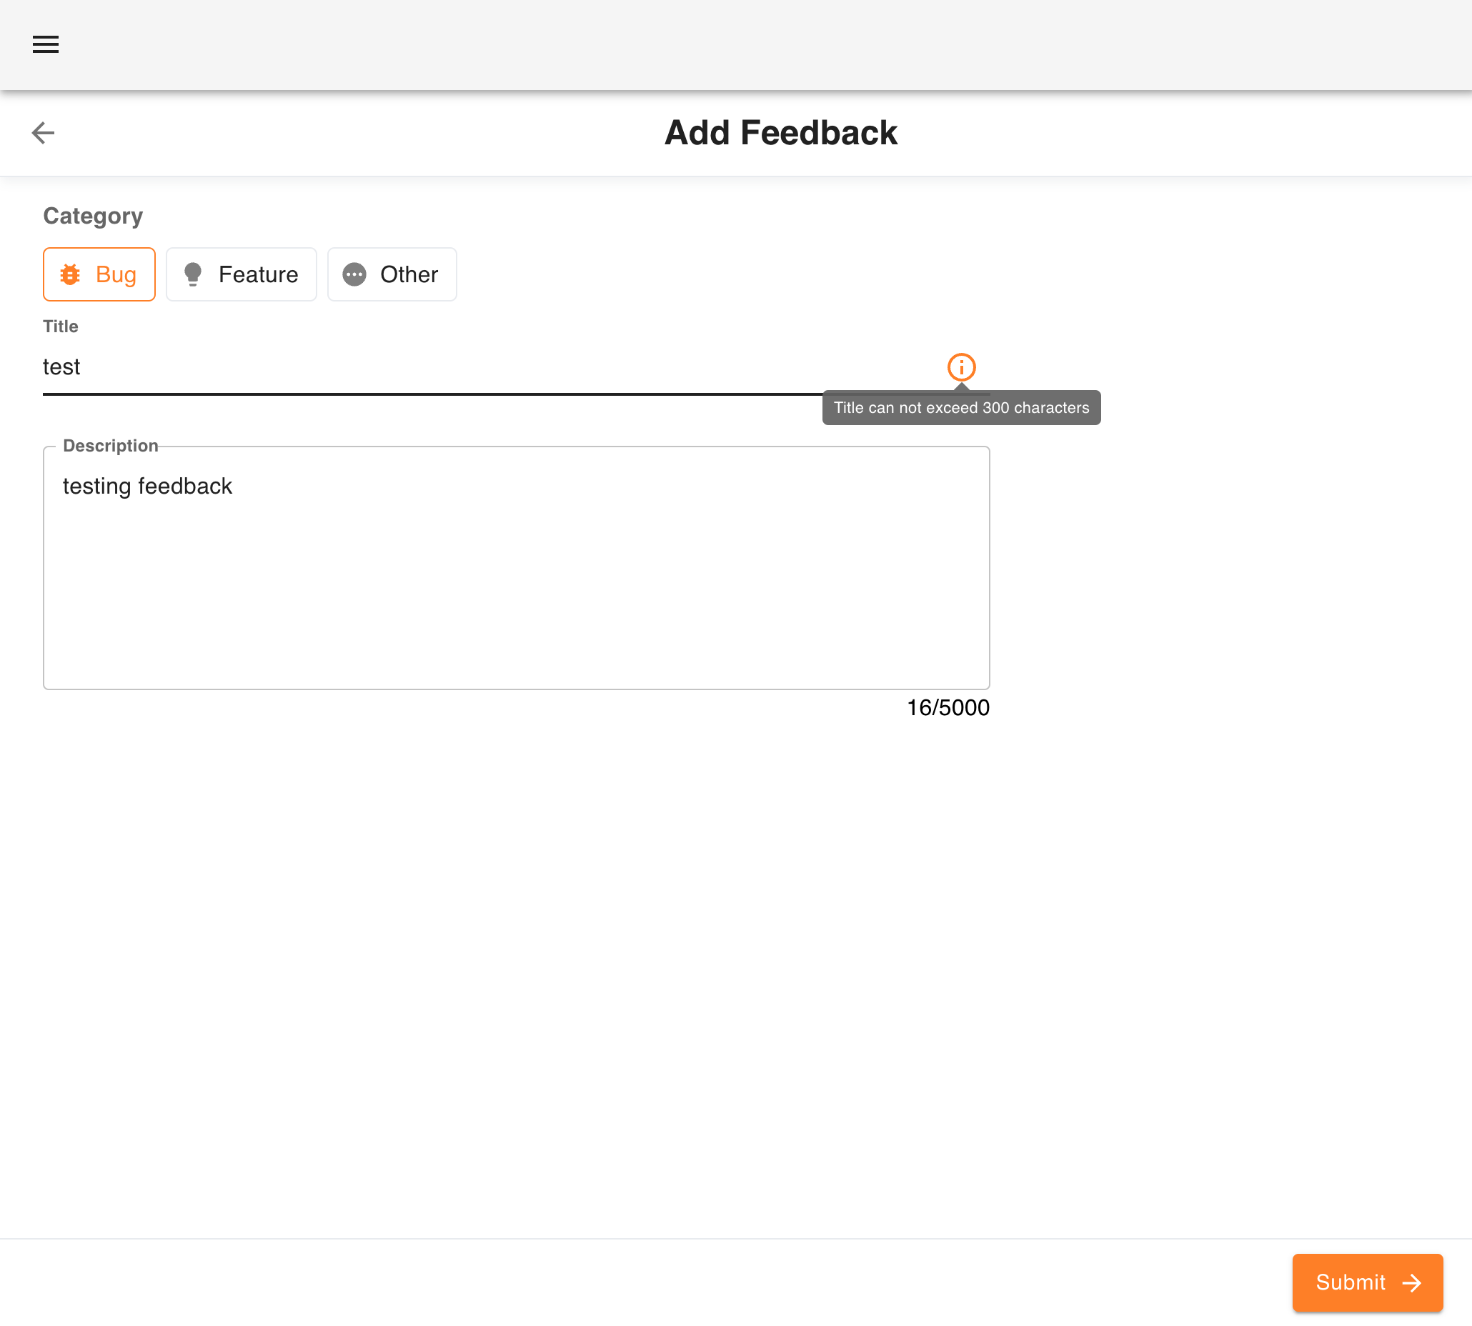
Project Details
Tirth Patel (20BCE223) B.Tech 8th Sem Major Project
Cloud Security Platform

Slide 36
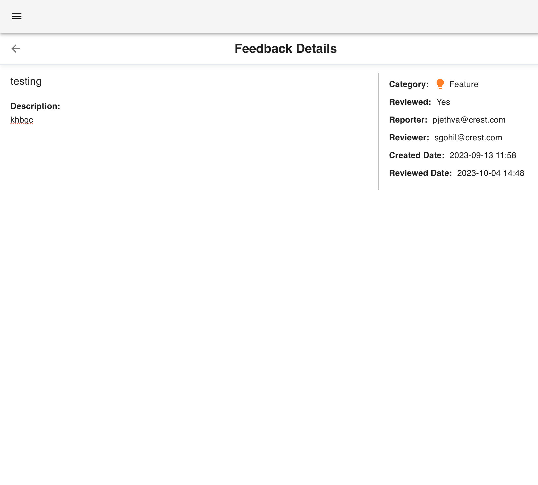
Project Details
Tirth Patel (20BCE223) B.Tech 8th Sem Major Project
Cloud Security Platform

Slide 37
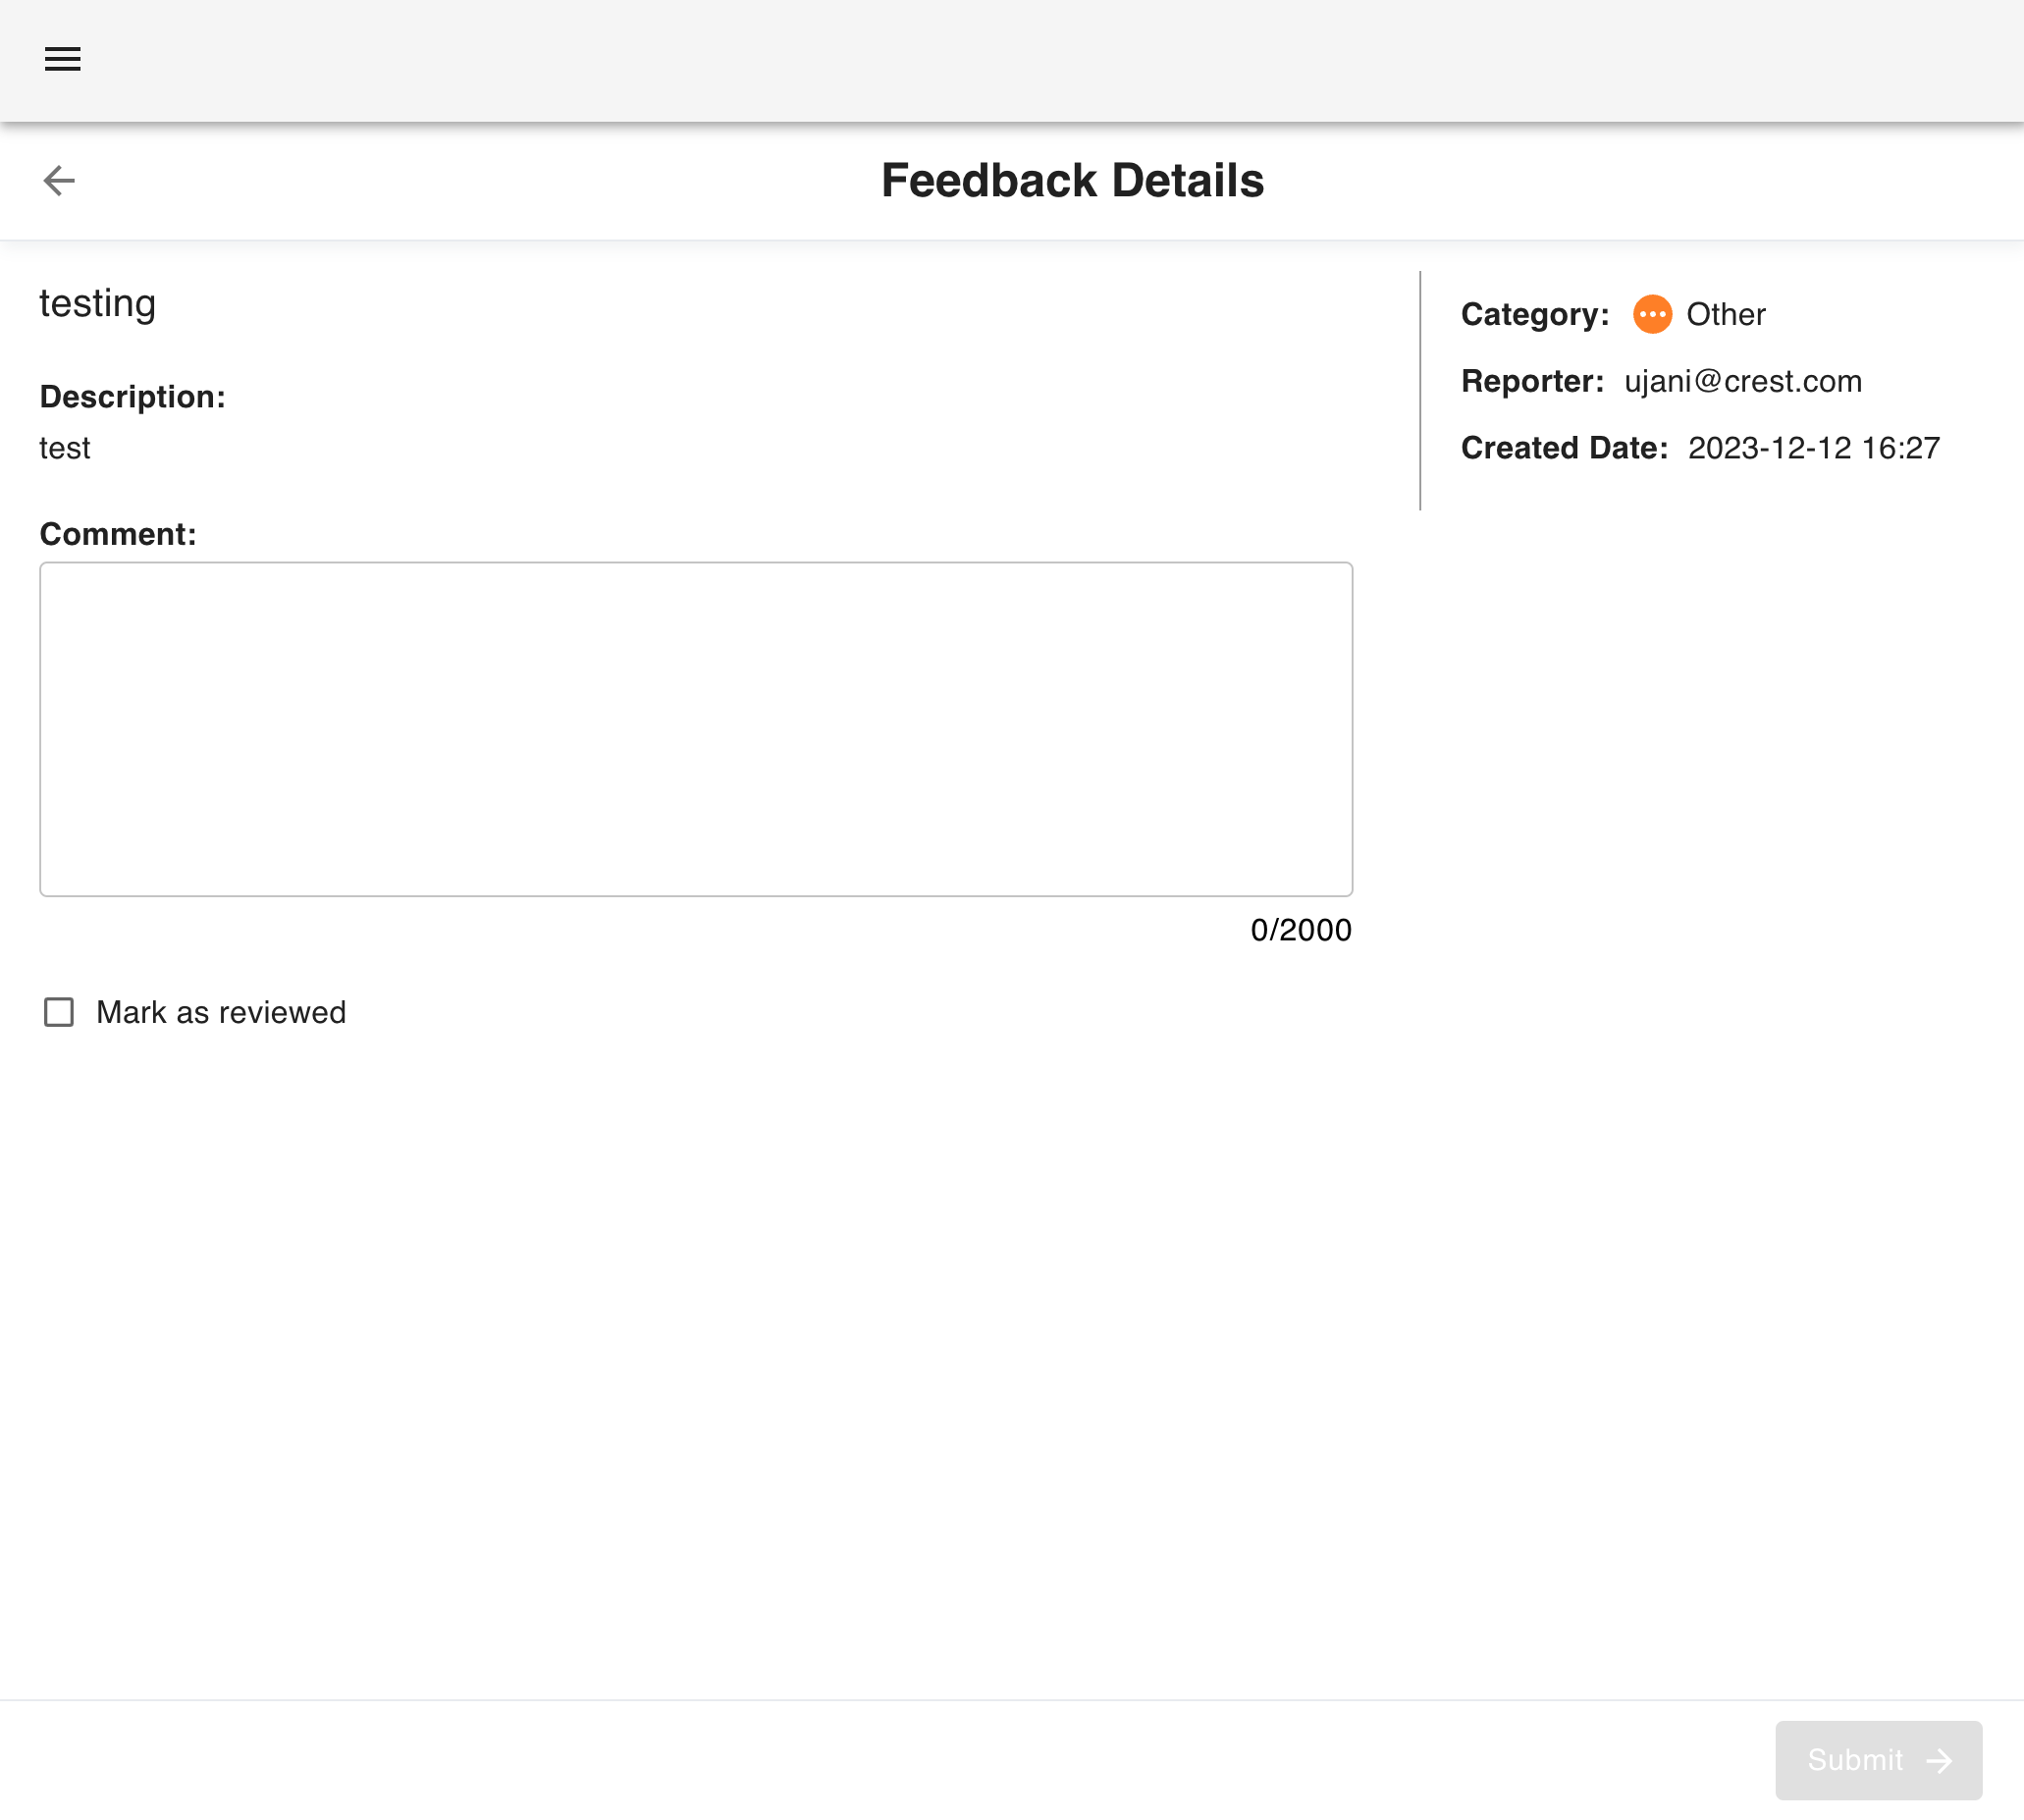
Project Details
Tirth Patel (20BCE223) B.Tech 8th Sem Major Project
Cloud Security Platform

Slide 38
Future Enhancement
Enhanced Monitoring and Alerting
Scalability and Auto-Scaling
Machine Learning Integration
Intelligent Resource Allocation
Enhanced User Experience
Security Enhancements
Tirth Patel (20BCE223) B.Tech 8th Sem Major Project
Cloud Security Platform

